Slide 1
How to become a

Slide 2
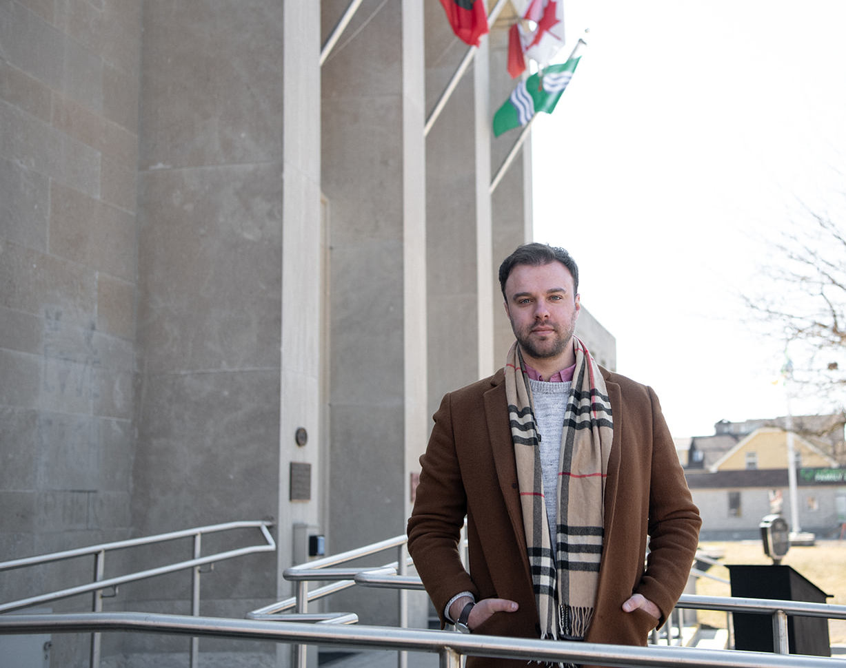
About Me
Current (and new!) role: Director of Philanthropy, Rainbow Railroad
Professional Fundraiser for 7 years, worked in nonprofit for 10 years including in healthcare, education (at Trent – hi Trent friends), and arts & culture in Peterborough & Toronto
Obtained CFRE in 2018, CFRE Ambassador since 2019
Volunteer & Community Manager

Slide 3
FAQs
Application cost: US$875 regular/US$700 participating organization member rate
Candidate Handbook, Test Content Outline, Glossary available at www.cfre.org

Slide 4
Why become a CFRE?
Demonstrate your fundraising knowledge to your colleagues, board, donors, and beyond
Improve fundraising knowledge
More valuable asset to your organization

Slide 5
Why become a CFRE?
Personal challenge I wanted to take on
Set an example for the team I manage
Lifelong learner
Increase my earning potential
Stand out when job seeking

Slide 6
CFRE certification process
Start My CFRE Application at www.cfre.org
Input your information
Select test window
Double-check your application
Submit and pay
CFRE staff reviews application
Upon approval, schedule your exam
Sit for exam
Recertify every three years

Slide 7
Start your application, for free!
Notes:
You can log in and out of your application as many times as you like. Only pay when you’re ready to submit.

Slide 8
Education
80 points earned within last 5 years

Slide 9
Education: Sessions
1 point = 1 hour in a session
2 points = 1 hour presenting a session with previously developed materials
3 points = 1 hour first time you present new material
36 points max can be counted for presenting
Up to 10 points max for attending relevant non-fundraising instruction
Session must be at least 45 minutes to qualify

Slide 10
Education: Service Learning
Up to 10 points = service learning (volunteering)
1 point per year per org as a volunteer
2 points per year per org on a committee or board
Notes:
Volunteering for a school or place of worship counts

Slide 11
Education: Authoring
5 points per published article
500 words or more
Self-published material is ineligible
15 points per book chapter
30 points per book

Slide 12
Education: Academic degrees
10 points = per bachelor’s, master’s, JD, or doctoral degree
any year, any major
5 points = per associate’s degree
any year, any major
Degrees can be combined in any way
40 points max from degrees
Degree not required

Slide 13
Education: What counts?
Webinars
Lunch and learns
Conferences
Audio/video recordings of conferences
Workshops
Master classes
Panel discussions
Roundtables
Academic courses
Certificate courses
Authoring

Slide 14
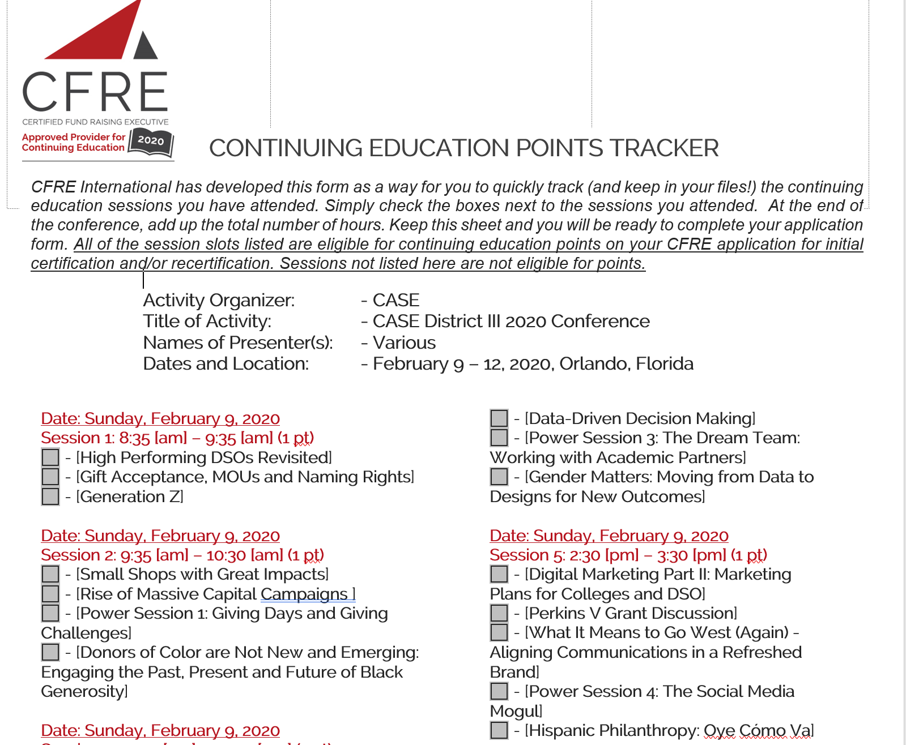
Education: What doesn’t count
Presentations you make for work (e.g., board presentations about your department, training staff)
Presenting non-fundraising material
Anything that happened more than 5 years ago (excluding academic degrees)
Networking event
Awards events
Mentoring session
Listening to podcasts

Slide 15
Subtract out
All breaks/meals
Networking time
Receptions
Any session you missed

Slide 16
I can’t remember what I attended
Old calendars
Old emails
Credit card statements
Old expense reports
Contact the organizer (this isn’t new to them)

Slide 17
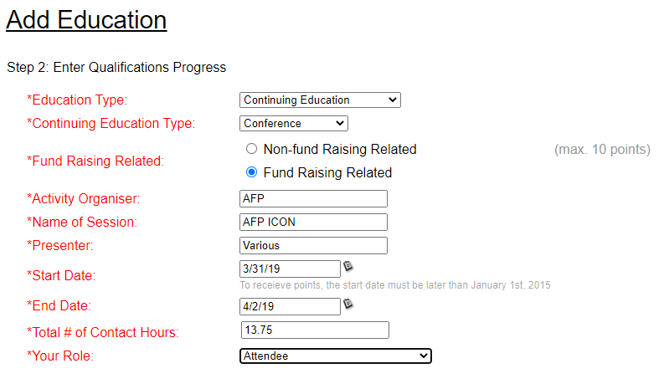
How to enter attending a conference in your application
Notes:
For conferences, don’t list each session/presenter. Only need one entry per conference you attend.
If you presented at a conference you also attended, you’ll need to make one entry for that conference for the session you presented and a separate entry for your time as an attendee.

Slide 18
Question break

Slide 19
Professional practice
36 points
1 point = 1 month
Note about consultants: Start counting from date of first client
Worked in a paid professional fundraising role for 36 months out of last 5 years
50% or more of your duties fundraising-related
20 hours a week = 100% of your duties fundraising-related
Not there? No sweat!

Slide 20
Professional Performance
55 points earned within last five years
1 point = US$25,000
US$1.375 million = 55 points
Events: Report gross
Planned gifts: Must have been received or be an irrevocable pledge
Secured grants count
Notes:
Fundraising is a team sport. For instance, if you were part of a team that held a fundraising gala that brought in $350,000, you can count that total in its entirety towards your application.

Slide 21
Professional Performance
Can earn points through management and/or communications projects
5 points per project
Must have start and end date
Not what you do week-in, week-out
Project examples on CFRE website

Slide 22
Update your application as you go

Slide 23
Storing documentation
Use personal email
Start “CFRE Proof” folder
Save soft or hard copies of event agendas
Keep all registration confirmation emails, agendas, receipts, etc. here

Slide 24
Initial certification cost
US$700 for members of participating organizations
US$875 regular rate
Pay when ready to submit application
Notes:
Cannot stack discounts. If you’re a member of two or more participating organizations, US$700 is lowest rate possible.
Cannot pay in installments. Full amount due at time of application. This keeps CFRE International’s processing fees and staff time lower so we can pass savings onto candidates.
Remember, US$700 will come back to you many times over the course of your career as CFREs earn more on average.

Slide 25
Initial application fee includes
Application review (no cost to resubmit)
All testing fees
Printing and mailing your certificate
Digital badge
Notes:
If you want a member of the CFRE certification team to look over your application before you submit, email succeed@cfre.org and request an application review. Please meet all points requirements before you request a review.

Slide 26
Question break

Slide 27
CFRE exam: Test windows
Select test window in application
US$35 fee to change windows
No fee if change needed due to COVID
One year to sit for exam after application approved
Notes:
Exam not offered in December.
Example: If you submit your application December 15, you’ll have until November 30 the following year to sit the exam.

Slide 28
How do I get started studying?
5 years or more of experience: Under 5 years of experience: 40 hours of studying at minimum 80 hours of studying at minimum
Determine what you need to study:
Resource Reading List
Rent, borrow, buy, listen

Slide 29
Six Knowledge Domains
Topic | Number | Percentage of Exam
Current and Prospective Donor Research | 28 Items | 14%
Securing the Gift | 46 Items | 23%
Relationship Building | 52 Items | 26%
Volunteer Involvement | 16 Items | 8%
Leadership and Management | 38 Items | 19%
Ethics, Accountability, and Professionalism | 20 Items | 10%
Notes:
These are the six Knowledge Domains covered by the exam. Be sure to study up on Securing the Gift and Relationship building as they comprise 49% of the exam.

Slide 30
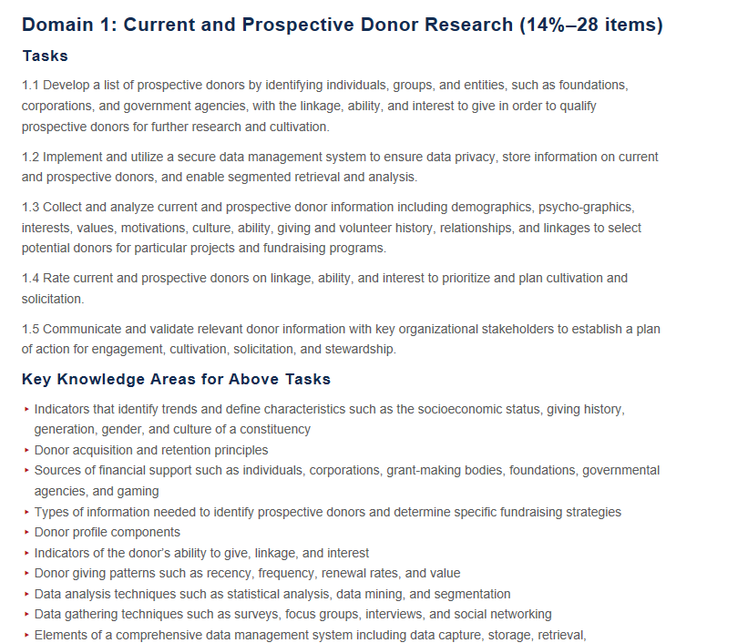
Breakdown of Knowledge Domains

Slide 31
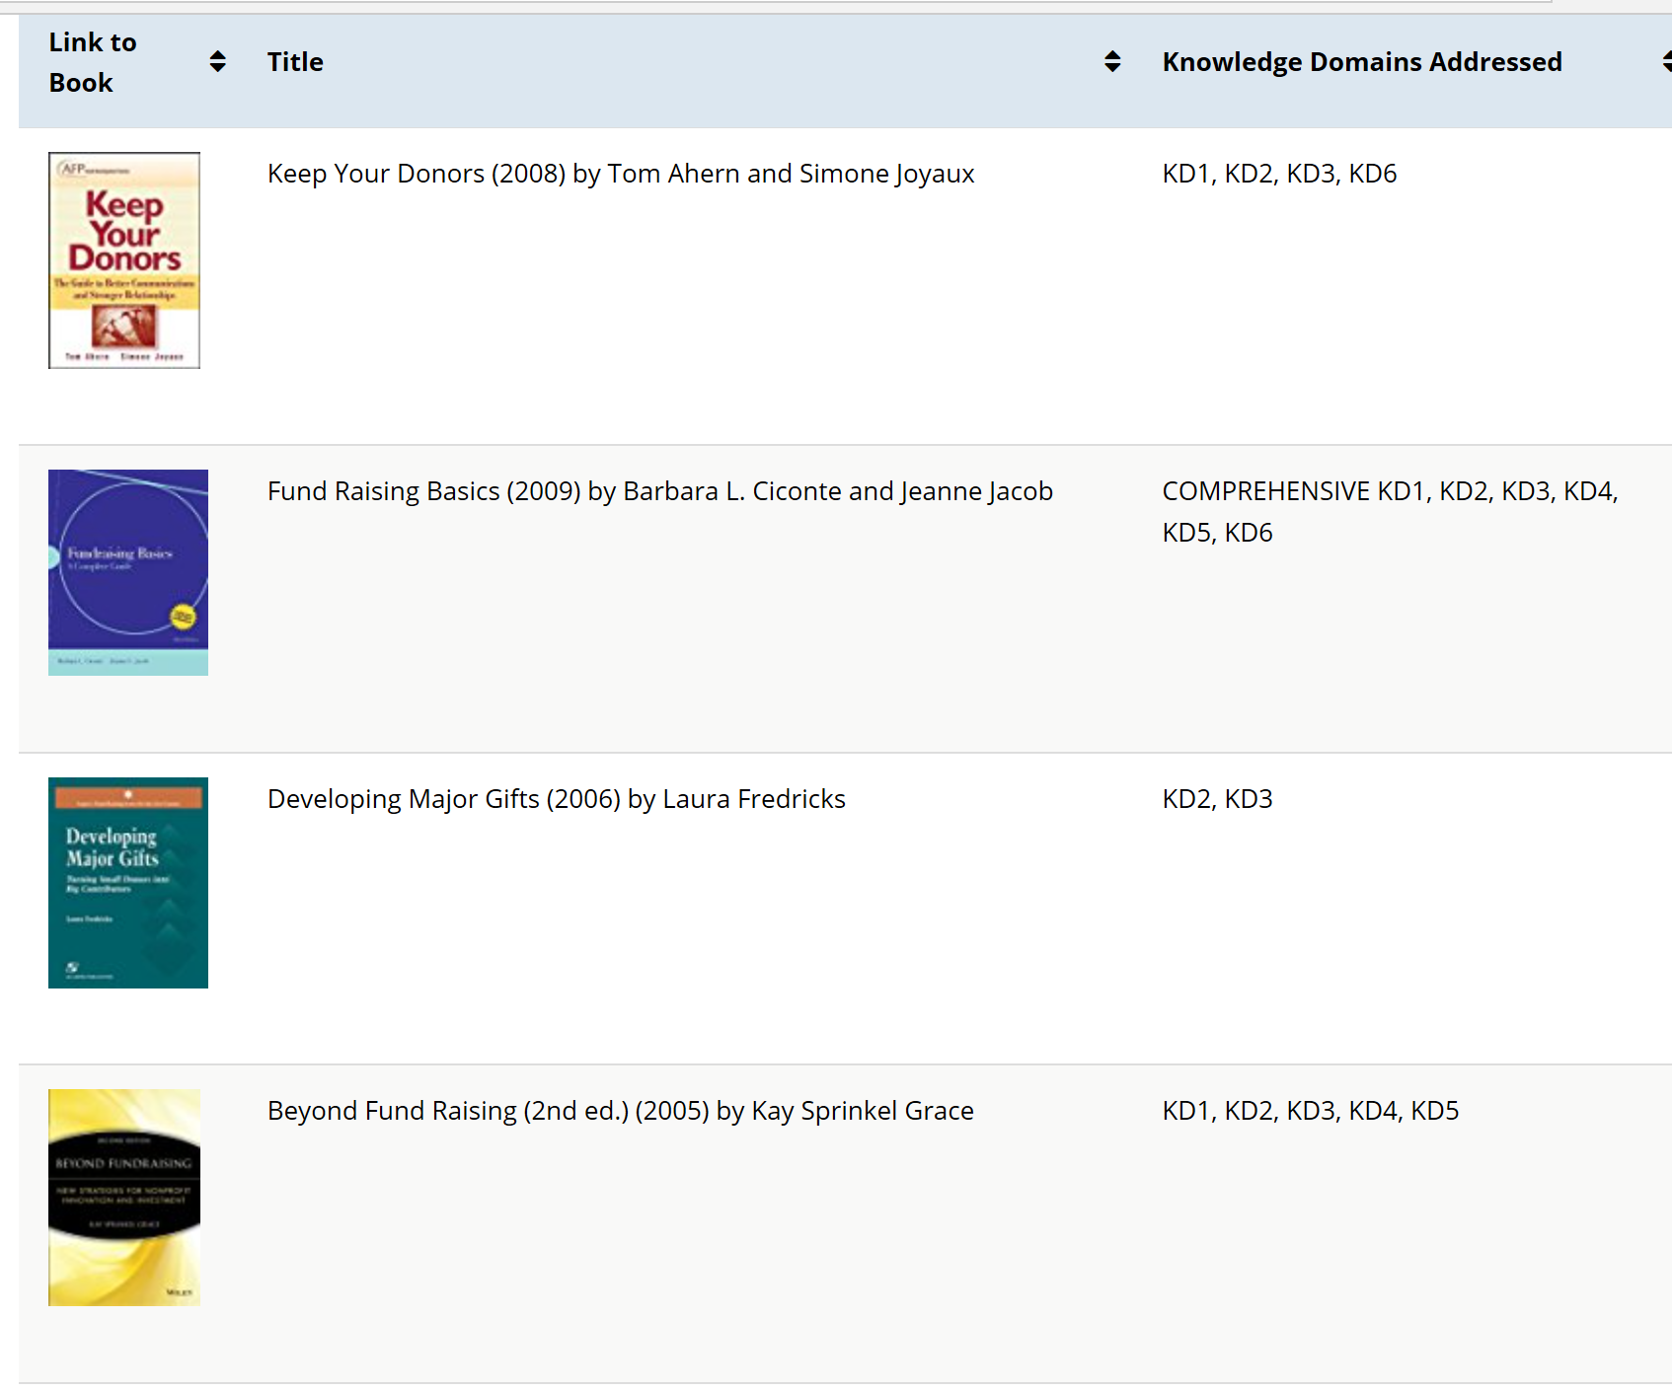
Resource Reading List
Pick 1 – 3 books from Resource Reading List based on which knowledge domains they address
Borrow books from library or new CFREs
Request employer to purchase for your team
Divide and conquer with others in your study group
Notes:
Complete list in candidate handbook

Slide 32
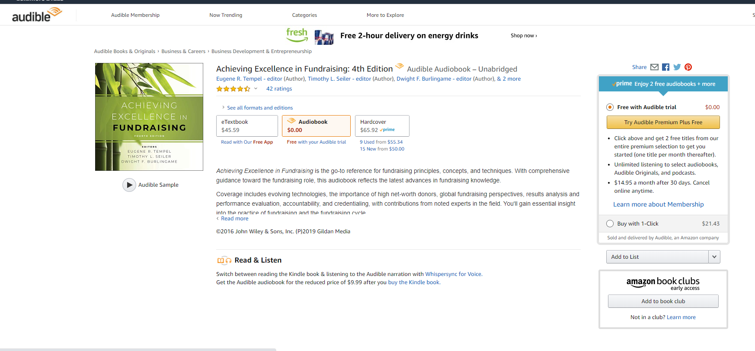
Occasionally “Achieving Excellence in Fundraising” audiobook is available free with an Audible account trial via Amazon

Slide 33
Free resources at www.cfre.org
Test Content Outline
Study plan template
Study groups
CFRE Central
Candidate Handbook
Glossary
Link to “CFRE exam: Setting yourself up for success” video on our YouTube channel

Slide 34
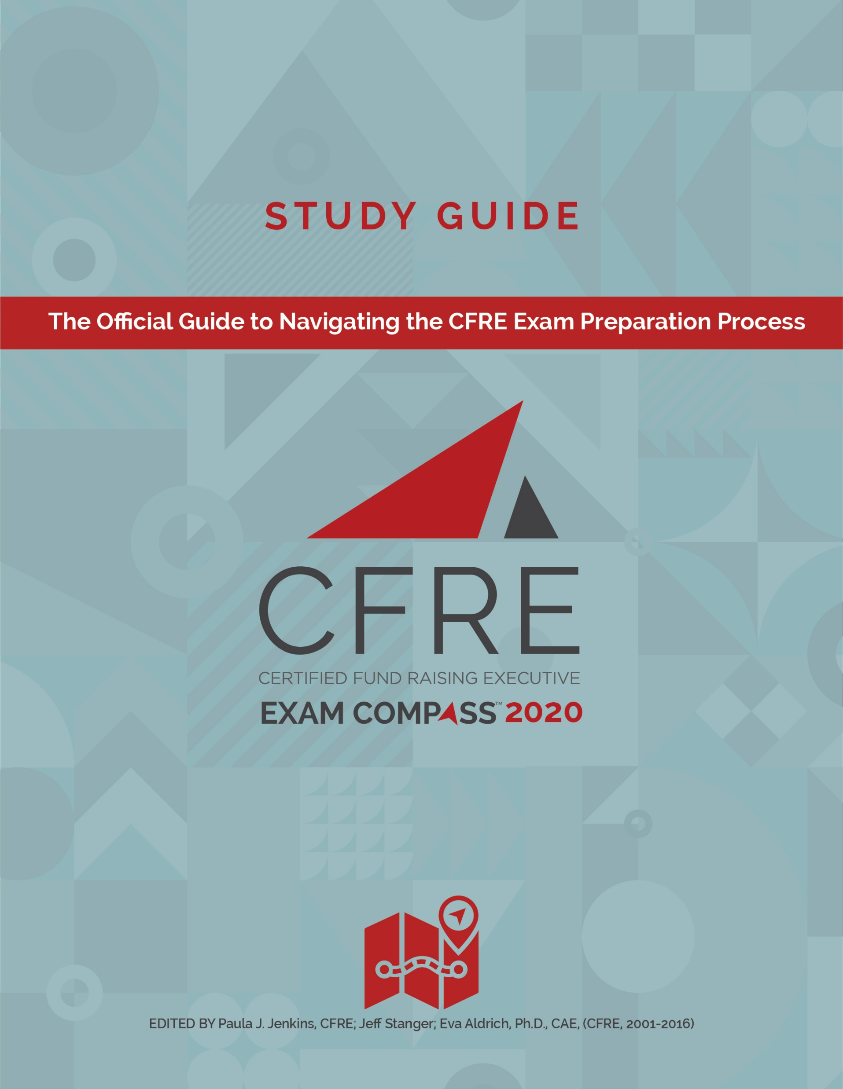
Additional resources
CFRE Exam Compass Study Guide
Available on Amazon
Official CFRE Exam study guide
Ideal if you need help structuring your study time/making a study plan
US$49.99
Practice exam (includes digital flash cards)
Available on CFRE website
Ideal if you don’t know what to study/take edge off test anxiety
US$59.95 for 30-day unlimited use
US$99.95 for 90-day unlimited use
Notes:
Items are optional. You do not need to purchase/use either of these to be successful on the exam.
A note on using the practice exam:
Take it once before you study to find your areas for improvement. Take it again after you study to check if there are any areas you need to devote more study time to.
Some people take the practice exam so many times they memorize the correct answers. This will not help with your critical thinking on exam day.

Slide 35
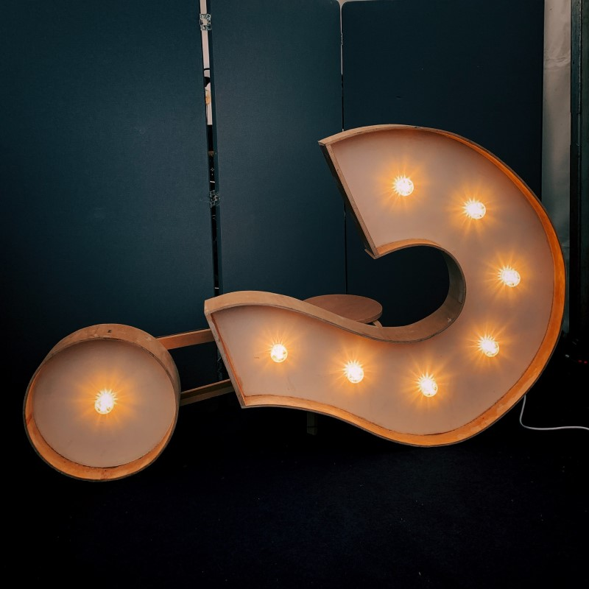
What’s the CFRE exam like?
Exam is global
Computer-based
No country-specific questions
Written at 5-year practice level
200 multiple-choice questions
4 options per question
Best answer
Best practice
Notes:
Whether you sit for the exam in San Jose or Santiago, it is the exact same worldwide.

Slide 36
What’s the CFRE exam like?
4 hours to sit for the exam
Every question ties back to a point on Test Content Outline
Move backwards & forwards
Score range: 200 – 800
500 is passing score
Information on how exam is scored available on CFRE website
Notes:
Majority of people finish the exam with time to spare.
You can go back and check your answers if you finish before the 4 hours is up.

Slide 37
Two exam options
Your home or office with OnVUE
In-person at a Pearson VUE test center
Notes:
Note that if you take the exam from your home or office, your computer will need to pass the OnVUE systems check. You cannot leave the room for the entire time when testing from your home or office. This means no restroom or food breaks.

Slide 38
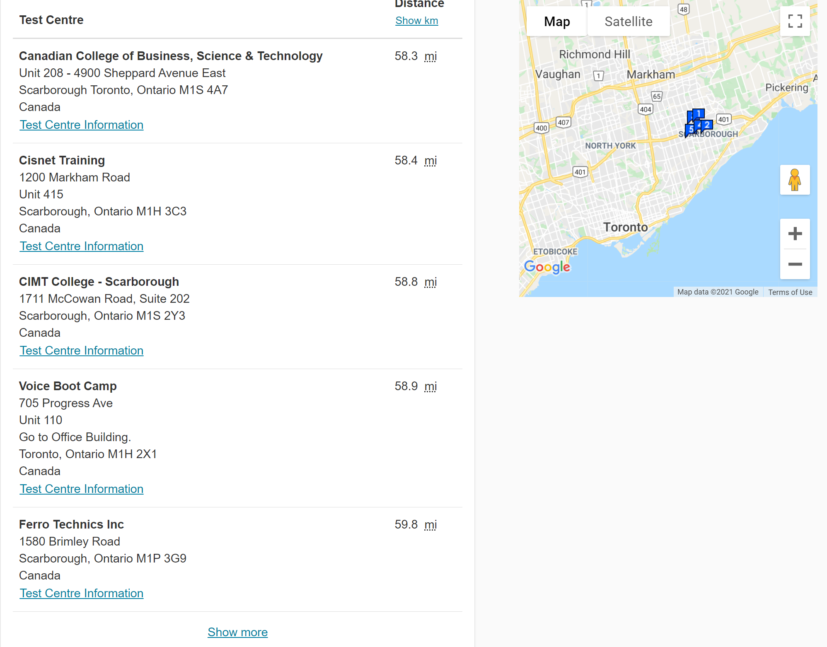
www.pearsonvue.com/cfre
Notes:
Visit pearsonvue.com/cfre to find your nearest test center. If test centers are open, they are following strict COVID guidelines. Learn more about these at pearsonvue.com.

Slide 39
When you finish
Score appears immediately
Won’t see what questions you got right or wrong
Confirmation email within one business day from CFRE International
Add CFRE to your business cards, LinkedIn profile, email signature, etc.
Certificates mailed monthly
Digital badge within a week
Notes:
To protect the integrity of the exam, you won’t see what you got right and wrong. This keeps the exam secure and prevents question leaking.
WAIT until you get the confirmation email from CFRE International before publicly announcing you passed the exam.
It takes CFRE 24 hours to get your results from Pearson Vue. If your boss contacts CFRE International to verify you passed before Pearson Vue sends the data, CFRE International cannot confirm you passed.

Slide 40
Talk to your boss
Over 50% of CFREs say their employer paid all or part of initial certification fee
Build into your next job’s contract
Purchase books
Day off before exam
Invest in staff to be even more proficient in their roles
Notes:
Some people make an arrangement with their employer. The candidate will pay upfront and when they pass, their employer will reimburse the fee. If you want to go this avenue, consider putting this agreement in writing with your employer prior to submitting your application.

Slide 41
Recertification
Recertify every 3 years
To recertify, complete online application
Recertification fee: US$510 regular price, US$408 for participating organization members
No exam required for recertification
Notes:
As a courtesy, CFREs due for recertification are sent notice of the deadline and process for recertification to their e-mail address of record beginning four months prior to the certification expiration date
It is the CFRE certificant’s responsibility to know his/her recertification due date and recertify by the due date.
Application must be submitted and approved for recertification to be granted

Slide 42
Recertification
45 points in continuing education
30 points in professional practice
40 points in professional performance
Notes:
If you cannot meet these points requirements, contact succeed@cfre.org to discuss.
If you work fewer than 30 months in three years due to maternity leave, medical leave, or unemployment, contact CFRE. They will be happy to work with you.

Slide 43
Next steps
Start your application
Log as much information as you can
Keep track of education points as you earn them
Speak to your boss about supporting your CFRE journey

