Slide 1
Professional Accreditation CFRE International
May 28, 2015
Peterborough Area Fundraisers Network
Theresa Butler-Porter CFRE
Lakefield College School Foundation

Slide 2
For me, or not for me?
Notes:
Or…. Simply… Is this something you could see yourself pursuing “CFRE--- For you or not for you?

Slide 3
Agenda
Objective
CFRE International (Certified Fundraising Executive)
Mission
About CFRE International
Certification
Fundraising as a Profession
Why CFRE???
The Process
Certification/Application
Facts and Figures
‘Almost’ last word
Questions
Notes:
Oh .. And one more thing. I promise you ..this presentation may not answer all – or any of your questions- but I do hope it acts as a catalyst for thoughtful reflection about ‘this CFRE” thing

Slide 4
Objective
To activate your curiosity button and inspire you to explore the possibilities.
Notes:
My job is to give you the tools / secret keys/ to activate your curiosity button… ---- this is about investing in yourself…. you are the only one who can calculate what the ROI – the Return on that Investment- will look like.

Slide 5
CFRE International
Mission
CFRE International certifies experienced fundraising professionals aspiring to the highest standards of ethics, competence and service to the philanthropic sector.
Vision
A world where philanthropy is practiced in an environment of trust, respect and accountability.
Notes:
reason for being….

Slide 6
CFRE International
• Is governed by currently certified fundraising professionals elected by the certificant population
• Is the only internationally recognised baseline credential for fundraising professionals
• Partners with participating, leading philanthropic organizations
• Is accredited by the National Commission for Certifying Agencies (NCCA)
• Has 5,600+ CFRE certificants worldwide
Notes:
The organizaton….

Slide 7
CFRE Certification
Is an assessment process for individuals
Requires professional experience (5 years)
Indicates mastery of knowledge assessed through an exam
Is awarded by CFRE International, (a third-party, standard-setting organisation
Standards set by a thorough, defensible, industry-wide process resulting in outline of required knowledge or skills
Results in a designation to use after one’s name (CFRE)
Has on-going requirements in order to maintain; holder must continue to demonstrate he/she meets requirements
Notes:
What it is

Slide 8
CFRE: Fundraising as a Profession
Recognised body of knowledge
Continuing education for professionals
Guided by a Code of ethics
Research studying the profession
Continuing education for professionals (offered by Participating Organisations, college and universities)
Certification of professionals – provided by CFRE International

Slide 9
Notes:
So… why do I need to bother??
Speak to the survey of 15 people I admire across Canada…. While CFRE has amazing resources on line --- It was natural for me to reach out.. And find out what my sheroes and heroes felt about CFRE and the world of philanthropy
So… Why would someone want to become CFRE certified?

Slide 10
Credibility
“I believe it proves to your peers and employer that you have an overall understanding of the discipline.
Attaining CFRE certification reflects one's dedication to the profession and is credible evidence to the external community of your commitment to a disciplined approach to fundraising.”
Notes:
CFRE certification serves as an impartial, third party endorsement of your knowledge and experience against international standards in philanthropy. It adds to your credibility as a fundraiser and sets you apart from other professionals

Slide 11
Achievement
“Achieving CFRE certification represents a baseline standard and mastery of the conceptual knowledge and practice of our field;
It demonstrates a commitment to ethical leadership, which is vital to our sector given that we trade on trust;
It demonstrates professionalism to our colleagues in other parts of the institution, as well as to our donors and volunteers;
For the individual fundraiser, it helps them to stand out in their career path/option, and demonstrates a commitment to the sector.”
Notes:
CFRE certification is a reflection of personal achievement because the individual has displayed mastery of his or her field by meeting requirements and standards set in philanthropy. – 86% of candidates report these as main reasons for pursuing certification

Slide 12
Commitment
“If you are going to fully engage in advancing ethical philanthropy throughout the world, you need to invest in the profession, support credentialing orgs like CFRE (or equivalent), engage in continuing education, and adhere to the highest ethics and standards of professional practice.”
Notes:
Receiving CFRE certification shows your peers, supervisors and, in turn, donors your commitment to your chosen career and your ability to perform to set standards. CFRE certification programme seeks to grow, promote and develop certified professionals, who can stand “out in front” as role models in the fundraising field.

Slide 13
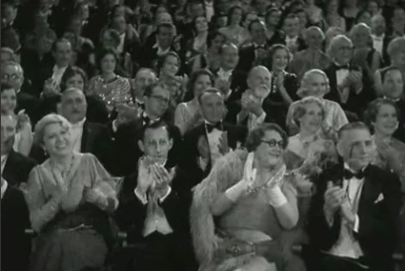
Recognition
Notes:
As a CFRE certificant, you can expect increased recognition from your peers for taking that extra step in your professional career. Debbie McGarry – who was the CEO at PRHC Foundation encouraged me to pursue CFRE --- When I achieved it… she was one of the first people I told. I had moved on --- but she had given me the courage and support to move ahead. I had to do the heavy lifting … but she anchored me.
It is something to be proud of .. And only people who get it… who are your tribe… can appreciate what an achievement it is

Slide 14
Personal Satisfaction
“Follow your passion. Only take opportunities that you know you can be passionate about.”
Notes:
CFRE certification is a step toward defining yourself beyond a job description or academic degree while gaining a sense of personal satisfaction

Slide 15
Responsibility/Knowledge/Skills
Notes:
Indicates your willingness to invest in your own professional development. YOU are 100% responsible for your achievements. As a leader, you want team members who take initiative, can be autonomous---and self directing Ultimately – as long as you take up space on this planet -YOU are responsible for YOU
Showcases your individual mastery by confirming proficiency and knowledge in the field. CFRE certification is about learning and understanding – a body of knowledge in a number of areas.
Is required every three years, proving you stay ahead of the curve in fundraising. There is no room for a rusty saw in the tool box

Slide 16
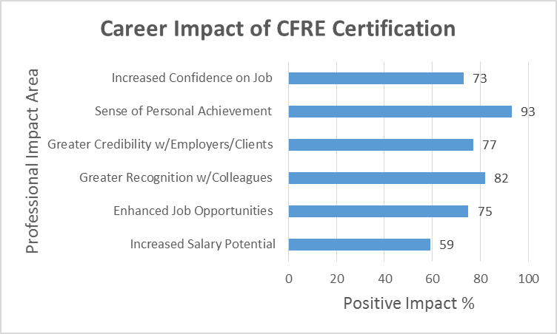
Notes:
2014 survey

Slide 17
Certification
Application - a written application with a point-system to demonstrate your experience – online
Examination - a standardised, multiple-choice exam of 200 questions
Accountability Standards - promoting integrity, ethical behaviour and the Donor Bill of Rights
Recertification - reassessment every three years required to continue to be certified
Notes:
So what are the pieces of certification?

Slide 18
Application
Go to www.cfre.org, click on “My CFRE”, create a secure, online account.
Enter your data as you go throughout the form. The system allows you to log in and out of the form, saving information as you go.
The form calculates your required points and turns green when you have documented enough points.
When you are ready to apply and have your application evaluated, submit your application online to CFRE International.
Creating an online account is free. You pay application and testing fees when submitted
Notes:
This is the ‘doing’ part. I challenge you to go to the site today – start the application --- I guarantee that you will be surprised at what you have already achieved.

Slide 19
Facts and Figures
Global credential – recognized worldwide
5600+ CFREs worldwide
789 CFREs in Canada
451 in Ontario
170 in Toronto
3 in Peterborough
1 in Lakefield ☺
Certification is less expensive if you are a member of a participating organization (AFP, AHP etc)

Slide 20
The ‘almost’ last word…
“This is one of the most privileged sectors to serve in.
If you have the talents and gifts to work as a servant/leader in this sector, you will wake up each morning thankful for what your day will bring and never waiver from doing good.”
Notes:
Before I wrap up… another quote from …

Slide 21
So… ???
To activate your curiosity button and inspire you to explore the possibilities.
Notes:
On a scale of 1-10 ….

Slide 22
Questions

