Slide 1
Project Management
Introduction and Practical Application of Project Definition

Slide 2
Agenda
What is project management?
The case for project management
Project Phases and the basic framework of Projects
Getting a good start – definition/focus
A Simple and Practical Tool for your projects - Charter

Slide 3
What is Project Management?
The Project Management Institute (PMI) says project management:
“…is the application of knowledge, skills, tools and techniques to project activities to meet the project requirements and to deliver something of value to people.”

Slide 4
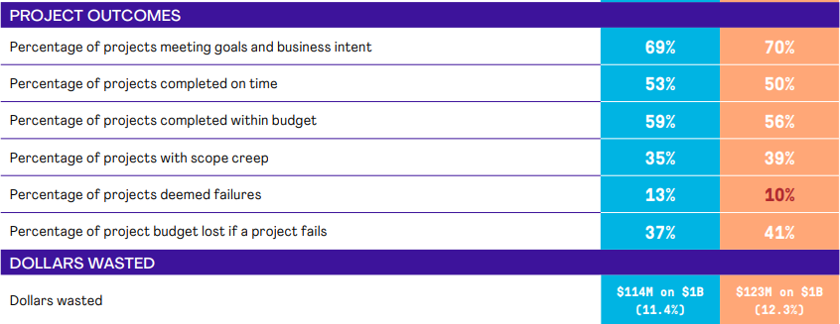
The case for Project Management
Lots of room for improvement by using Project Management

Slide 5
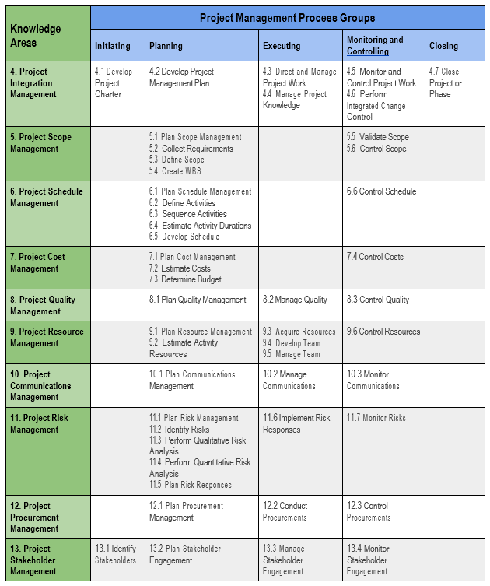
Project Phases and framework

Slide 6
Phases – practically speaking
Initiation
Planning
Executing
Monitoring and controlling
Closing
Ideas/Goals
Steps to accomplish goals
Getting it done/ Accountability
How did we do? How to Improve?

Slide 7
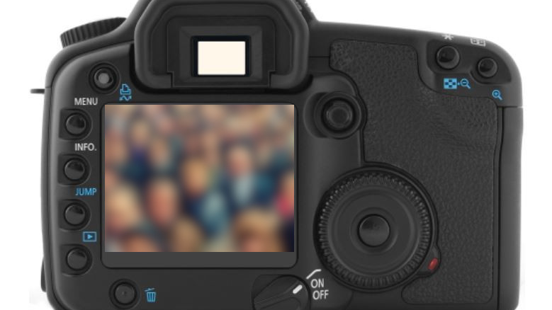

Slide 9
Project Initiation
“A lack of clear goals is the most common factor for project failure.”
Goals and objectives are decided on in the earliest stages of the project
Proper definition of goals, objectives, and deliverables allows the PM to guide the project more clearly
Clear project definition helps to manage stakeholder expectations
Source: https://teamstage.io/project-management-statistics/

Slide 10
SMART Objectives
S
Specific
M
Measurable
A
Time Bound
T
R
Relevant
Achievable

Slide 11
Simple Tool – Project Charter
Establishes a partnership between the requesting and performing organizations/parties
Formally initiates the project (sponsor approval)
Outlines basic roles and responsibilities
Clearly defines initial scope of the project: objectives, deliverables
Sets an initial timeline
Sets the initial budget
Identifies project stakeholders

Slide 12
Key Takeaways
Project management is all about bringing the right knowledge, skills, resources, etc. to meet the requirements of a project and create value
Project Managers use a framework to usher projects to completion (hopefully) within scope, on schedule, on budget, and with the desired quality
Many projects fail or do not accomplish their goals within budget and schedule – lots of room for improvement through application of PM
Most common reason for failure is lack of clear goals/definition
By organizing the goals/outcomes/deliverables in an intentional way using some PM tools (like the Charter) – better definition can be achieved, and hopefully can lead to greater success

Slide 13
Questions?
Jeremy Spencley, PMP
Fleming College
Program Coordinator – Project Management
Jeremy.Spencley@flemingcollege.ca

