Slide 1
Building communities via social media
Lois Tuffin
Editor in chief
Peterborough This Week MyKawartha.com

Slide 2
How to create content to draw people in
  using your stories and/or guest bloggers
How to use social media to get others to ‘sell’
  Facebook
  Twitter
    how to use Bitly to track traffic
    how to use hashtags
    Tying all the pieces together makes it more effective.

Slide 3
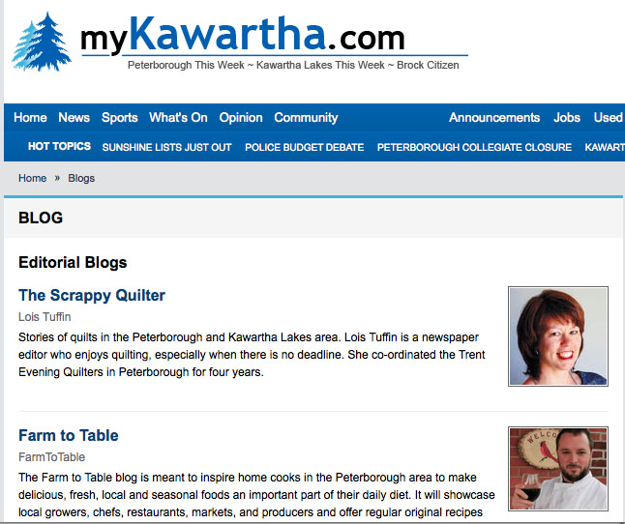

Slide 4
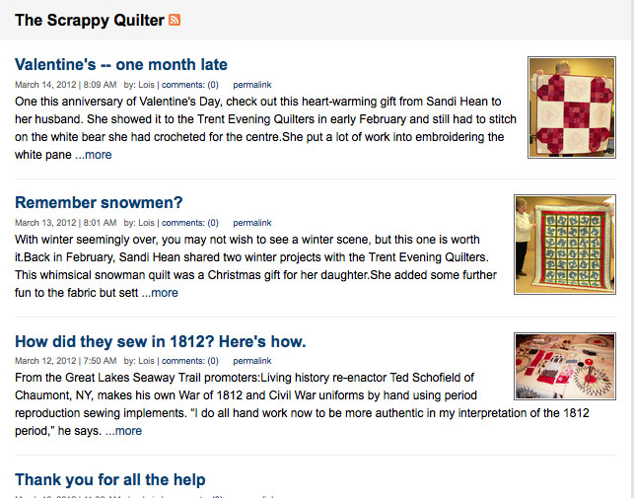

Slide 5
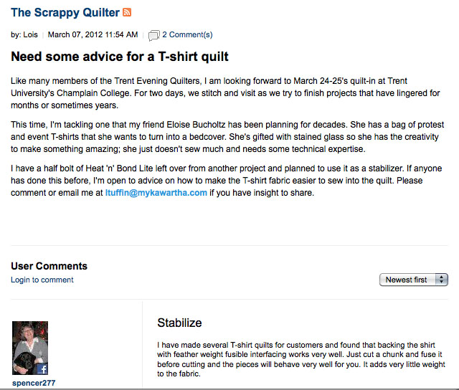

Slide 6
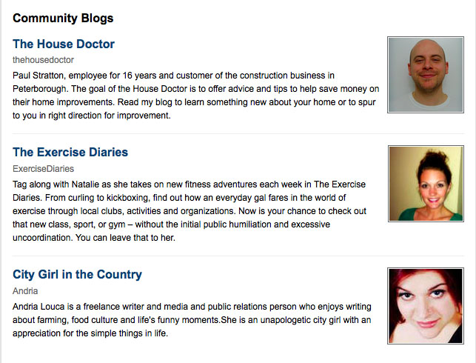

Slide 7
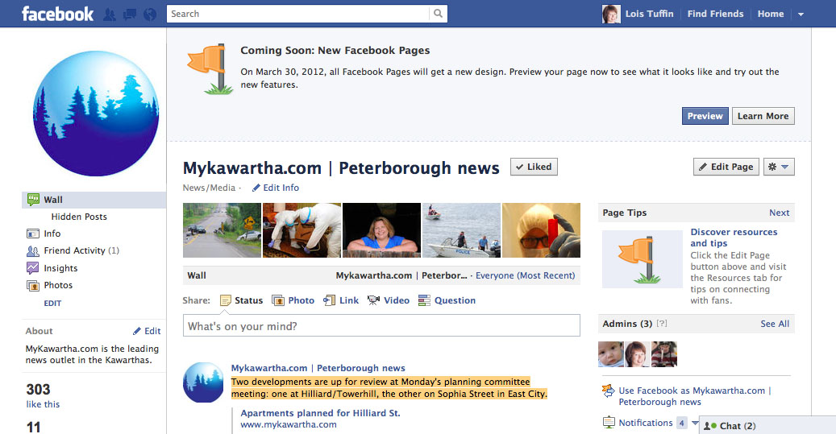

Slide 8
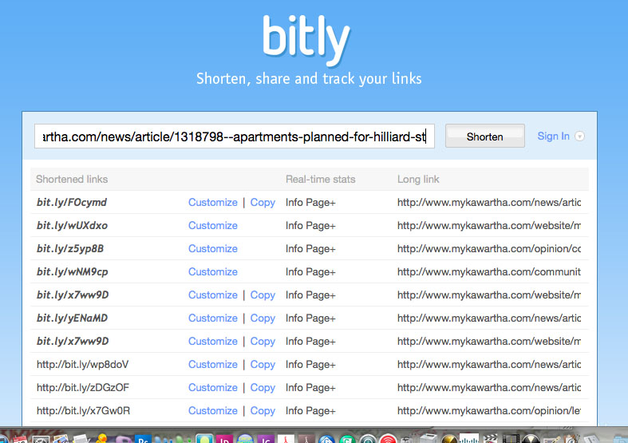
How to use Bitly.com

Slide 9
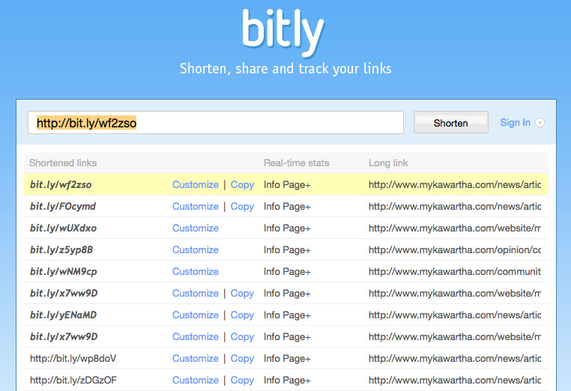

Slide 10
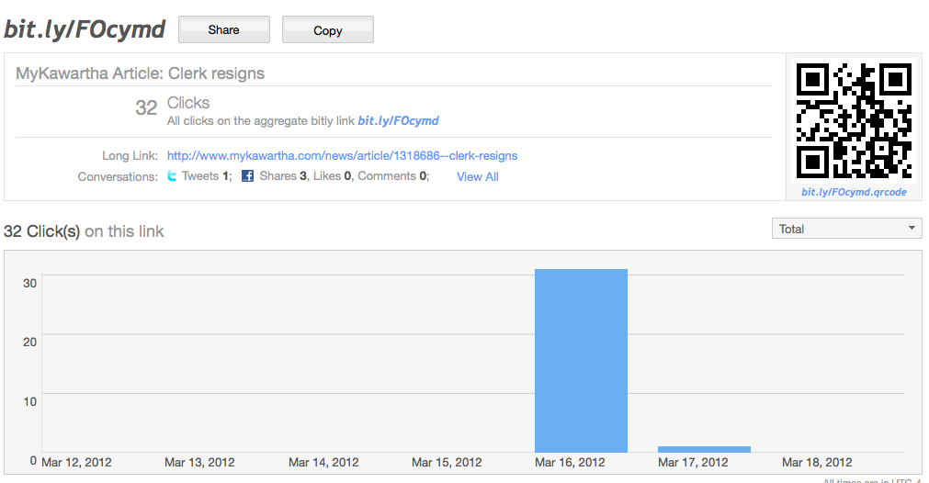
Tracking traffic via Bitly

Slide 11
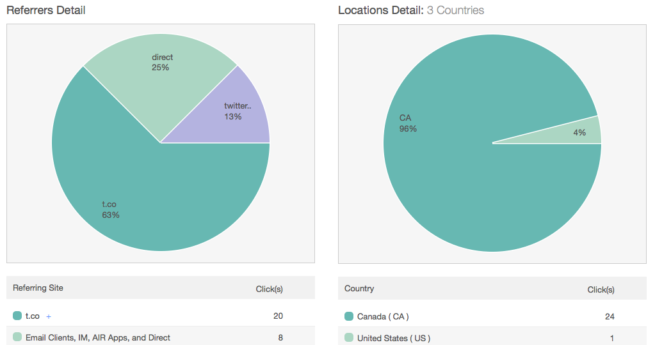
Tracking traffic via Bitly (part 2)

Slide 12
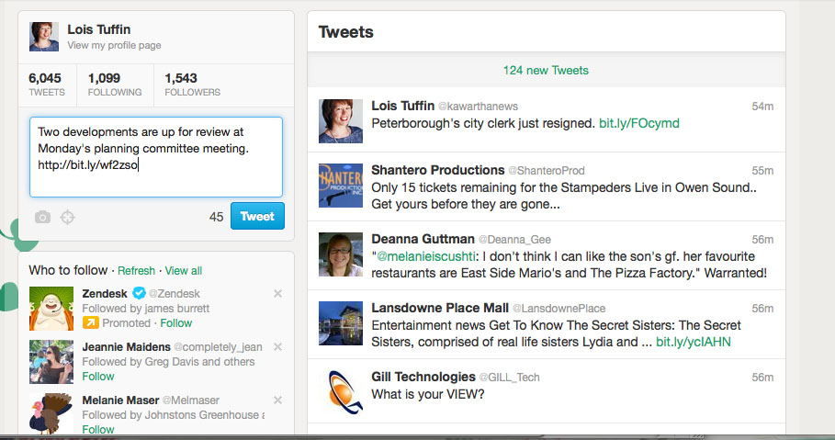
Twitter @kawarthanews

Slide 13
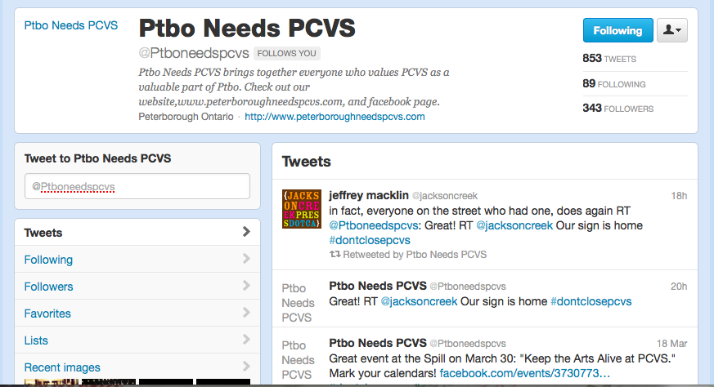

Slide 14
Remember:
Create interesting content
Bring others into the conversation
Tie all the pieces together

