Slide 1
The Data Part of the Story
April 22, 2021
Judith Koke
Institute for Learning Innovation
Judy.koke@freechoicelearning.org

Slide 2
Logic Model
â
Situation/
Needs Assement
Inputs
Outputs
Outcomes to Benefits
Steps
Volunteers
Time
Equipment
Money
Materials
Participants
Youth
Family
Community
Camp
Organizations
General public
Outcomes
Learning
Awareness
Knowledge
Skills
Aspirations
Motivations
Impacts
Actions
Behaviours
Practices
Decisions
Policies
Benefits
Goal
Activities
Workshops
Programs
Public campaigns
Interactive learning activity
Problem Definition
Research
Goal
â
â
Data Source
Data Source
Data Source
Evaluation
Evaluation & Research
Research
Intervention
Time, Resources, Measurement…

Slide 3
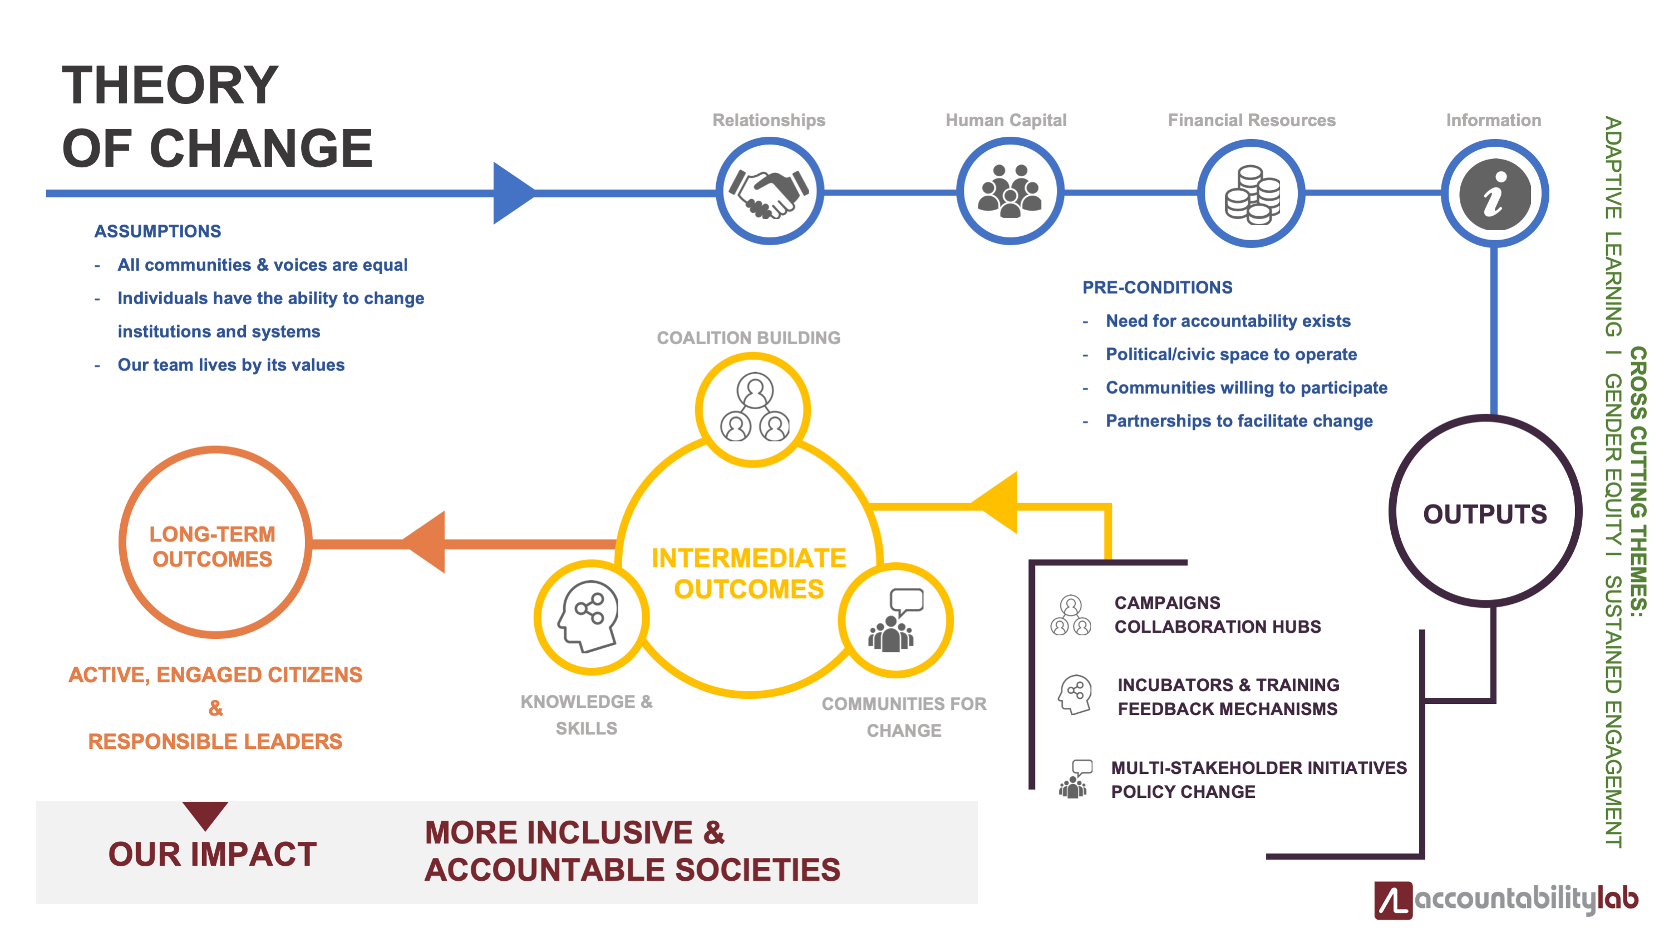

Slide 4
Logic Model Benefits
Clear story/overview for external audiences
Shared vision for internal audiences
Explicit intentions
Grounding practice in research
Clear definition of success

Slide 5
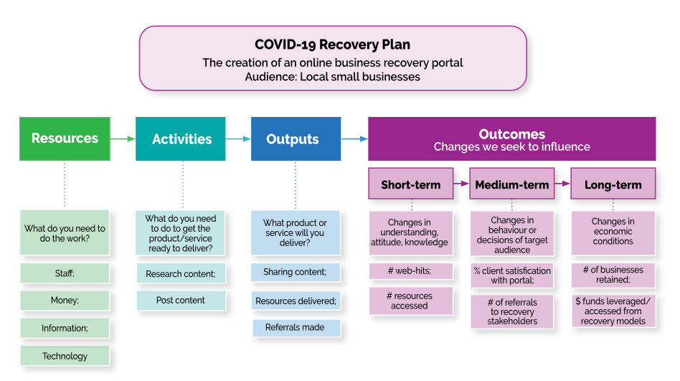
Ontario Regional Economical Development

Slide 6
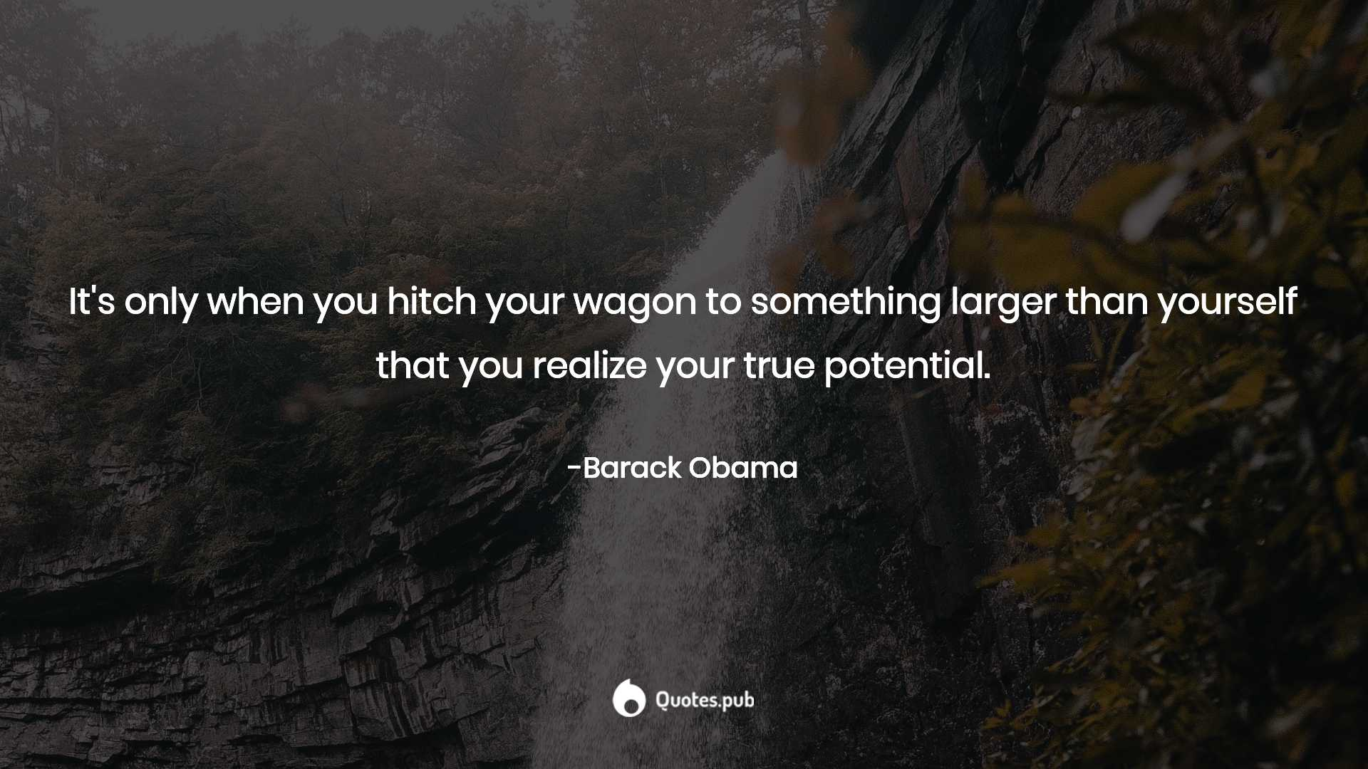
Role of Research

Slide 7

Use Research
To support the need and urgency
To support choice of intervention
To reach through outcomes to impacts
To reach through outcomes and impacts to benefits

Slide 8
Needs Assessment
How do you know there is a problem/need
What does research have to say about :
  the problem
  the future situation if the problem is unresolved
Are there others who have solved this problem before?
What is the ultimate goal of the project?
Research: find – or do community scan

Slide 9
Connect Intervention to Theoretical Frameworks
Experiential Learning Theory
  Boud & Walker; Schon; Dore & Herscovitz; Brookfield; Fenwick
Activity Theory (Community of Practice)
  Vygotsky; Lave &Wenger; Van Aalsvoort; Hung
Conservation Education
  Hungerford & Volk; Storksdieck & Heimlich
Possible Selves
  Stake & Mares; Markus & Nurius; Anderman
Notes:
Experiential Learning Theory
“do, reflect, apply” model, with a particular emphasis on expanding participants’ critical thinking skills and their ability to identify and challenge their assumptions. Experiential learning works from three basic orientations:
Much of the work in this area focuses heavily on process and on cognitive learning outcomes, and underemphasizes attitude and emotional investment,
Activity Theory
Another theory developed from a Vygotskian perspective, is “Community of Practice” (Lave and Wenger, 1991), which later evolved into “Activity Theory.”
It considers itself a theory of “Learning to be” in which learning does not only come through the accumulation of content and skills, but through the process of learning together - enculturation. The basic idea of enculturation is that through participation in an activity within a community, people’s behavior or identity change.
This framework has proven utility in examining program impacts and outcomes. Activity Theory are that individuals are not truly considered as separate learners – the unit of measurement = the community - , and thus individual outcomes are difficult to tease out.
Conservation Education
Conservation Education has long realized that to move learners to change behavior takes much more than content acquisition, it requires a change in attitude and personal connection to the environment In fact, science knowledge and achievement generally has been shown to be linked more closely to science attitudes than to aptitude,
Currently, Conservation Education uses the following types of measures in their assessment of program success:
Do participants exhibit a strengthened affective orientation towards nature?
Does participation in the program result in an increase in a sense of belonging to the environment, a sense of personal connection to the environment and even a sense of nature as ‘place.’
Do participants demonstrate improved critical thinking in the areas of conservation and stewardship?
Generally, conservation education is focused on the ultimate interactions of learning (cognitive, skill, and affect) and how they lead to increased action by the individual and collective improvement in ecosystems and ecological health indicators
Possible Selves
The basic concept of this theory base is that if programs wish to effect behavior change, they must first change self-concept (Markus, 1986). In short, a program may be measured as successful in how it impacts self-concept. The framework proposes that individuals’ perceptions of their current and imagined future opportunities, both hoped for and feared, serve as a motivator and organizer of the individual’s current task-related thoughts, attitudes and behaviors, thus “linking current specific plans and actions to future desired goals.”
Markus and Nurius’s research indicates that possible selves do function as motivators for future behaviors, both in the short and longer term (Markus 1975). Further work by Anderman (1998) indicates that present and future selves are related to achievement and to motivation, particularly during adolescence.

Slide 10
Outputs vs Outcomes
Output: organization’s product, activity, audience
Outcome: resulting change in knowledge, skill, behaviour or attitude
Good outcome statements are specific, measurable, and realistic
Measured through Evaluation

Slide 11
Impacts
Impact = the longer- term effect of an outcome.
Impact = a much broader effect
Being homed:
Outcome – security, warmth, health, comfort
Impact – employed, participate in community, training

Slide 12
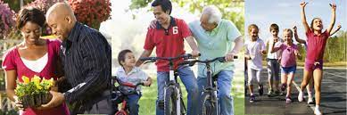
Benefit
Effect on wider public and society
Described by research – expensive

Slide 13
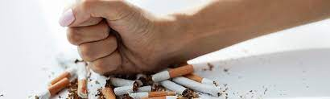
Smoking Cessation Program
Outcome – Impact - Benefit

Slide 14
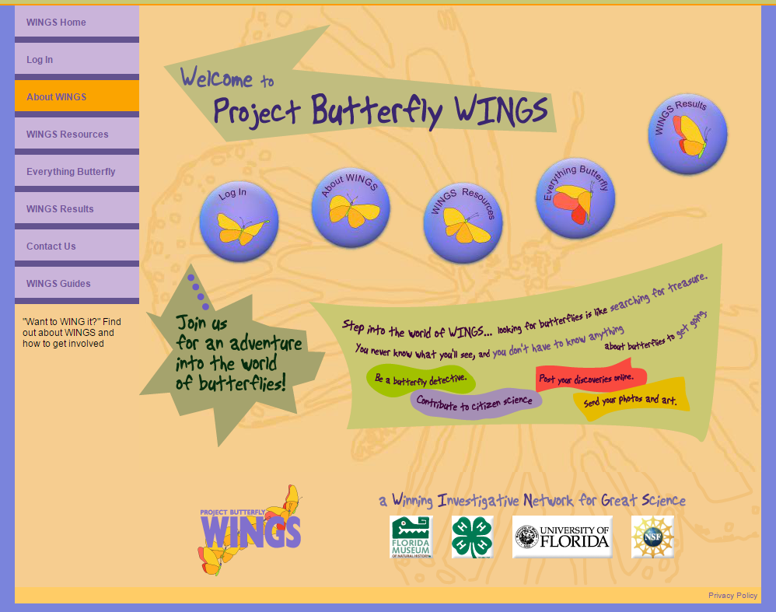
Notes:
Partnership Florida Museum of natural History, NSF, 4H, university of Florida
Citizen science project – youth learned about butterflies – engaged in real data collection – submitted data for scientists to use – learned how scientists used data –
Museum def’n of success: - NOT to learn lepidoptery – the science of butterflies and moths
Museum - originated and developed as a Citizen Science project – designed to engage youth in experiential learning about science processes –and their (the youth’s) relationship to the environment
4H- pushed that it contribute to the participant’s life skills, confidence and sense of future.
Don’t just what did participants learn – new science, new skills, - but so what – how shape their success as contributing citizens?
How find overlap and metrics?

Slide 15
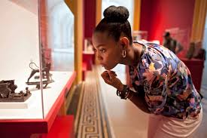
Positive Youth Development (PYD)
Lerner: King; Catalano; Lopez
6 C’s:
Cognitive and behavioral Competence
Confidence
Positive social connections
Character
Caring (compassion)
Contribution
Notes:
Positive Youth Development
Evolved from deficit model –
A fairly recent theory-based program framework is Positive Youth Development (PYD), which at its most general level, is the focus on supporting or promoting, during the second decade of life, the positive developmental processes that are known or assumed to advance health and well-being.
PYD occurs when youth interact with their environment and positive agents (defined as leaders who support healthy development and/or programs and organizations create climates conducive for growth or change) to meet their basic needs and cultivate assets. Through the youths’ motivation and investments, shaped and supported by positive agents, momentum builds and youth utilize assets to build additional psychological resources that facilitate growth. Ideally, PYD generates physical and psychological competencies that serve to facilitate the transition into an adulthood characterized by striving for continued growth.
The concepts that scholars of developmental psychology use to describe the characteristics of a positively developing young person have been described as the Five Cs:
cognitive and behavioral competence,
confidence,
positive social connections
character,
caring (or compassion).
Lerner (2004) has theorized that when young people manifest these five Cs across their development, they may be said to be thriving. It was later suggested that positive youth development (PYD) results in the emergence in an adolescent’s life of a sixth C, contribution to self, family, community, and ultimately, civil society. (King, 2005)

Slide 16

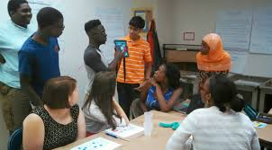
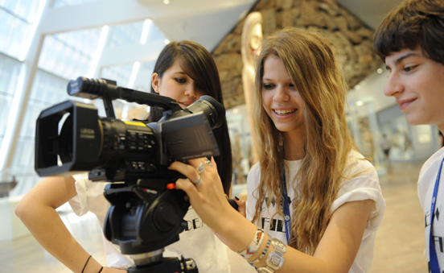
Evaluation Questions
What is PYD impact ?
Changes in interest and knowledge of nature and science process?
What learn about themselves ?
How impact affective relationship to the environment?
Compared to other 4H programs – how effective in supporting PYD?
Notes:
NOT instrument items – but what trying to learn

Slide 17
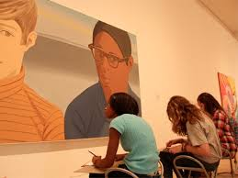
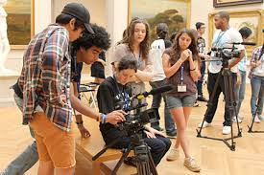
Survey
“For each idea tell us if being part of WINGS changed you not at all (1) to a lot(7)”
Being part of WINGs increased how much time I spend:
Watching TV shows about science
Noticing things about science in the news
Talking about science with my friends or family
Notes:
Survey - - Impact of participation in the program Developed and piloted with 66 youth in an alternate science offering – establish reliability and validity - IRB
Created colorful booklet – mailed 571 – return of 186 fully complete – 33% response rate
Focus Group – go deeper into the elements necessary o build confidence and how perceptions of afterschool program ‘science’ differ from school science
leader Inter
Instrument items views – impact on learning – impression of impact on youth – program improvements.
This was about leisure time – there was little impact

Slide 18
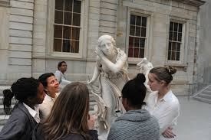
My WINGS experience has helped me feel:
Confident to try new things
More sure of what my strengths and weaknesses are
Able to accept responsibility
Willing to take on a leadership role
Want to help take care of the environment
I have a good future ahead of me
I am part of nature
I have better leadership skills
Notes:
Sense of self – this teams had strongly positive scores – indicating the impact of this program extends beyond science learning and contributes to the development of youth. Statistically more significant for young women then for young men –.

Slide 19
Data Collection
Online survey
Phone call/interview
Group Discussion
Group writing assignment
Paper survey
Longer term follow up
Observations
Informed Observer Input

Slide 20
Logic Model
â
Situation
Inputs
Outputs
Outcomes/ Impacts
Problem Definition
Research
Goal
Steps
Volunteers
Time
Equipment
Money
Materials
Participants
Youth
Family
Community
Camp
Organizations
General public
Short Term
Learning
Awareness
Knowledge
Skills
Aspirations
Motivations
Long Term
Actions
Behaviours
Practices
Decisions
Policies
Impact
Goal
Activities
Workshops
Programs
Public campaigns
Interactive learning activity
â
â
Data Source
Data Source
Data Source
Evaluation
Evaluation & Research
Research
Intervention
Time, Resources, Measurement…

Slide 21
Q & A
&
Discussion
Outcomes for your program
Examples of how to measure

