Slide 1
Customer Centric Innovation

Slide 2
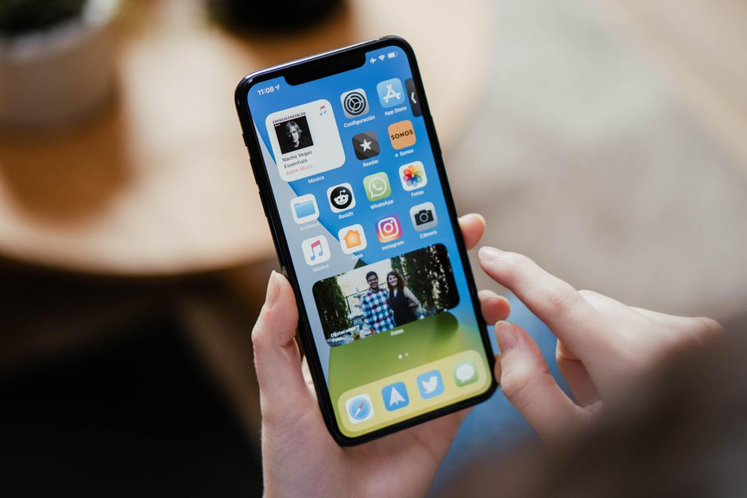

Slide 3
CUSTOMER CENTRIC INNOVATION
HOW CCI APPLIES TO NON-PROFITS
Notes:
WHY – why is it important?
HOW – how do you do it effectively
WHAT – what does it mean for non-profits

Slide 4
THE ZERO IN FORMULA

Slide 5
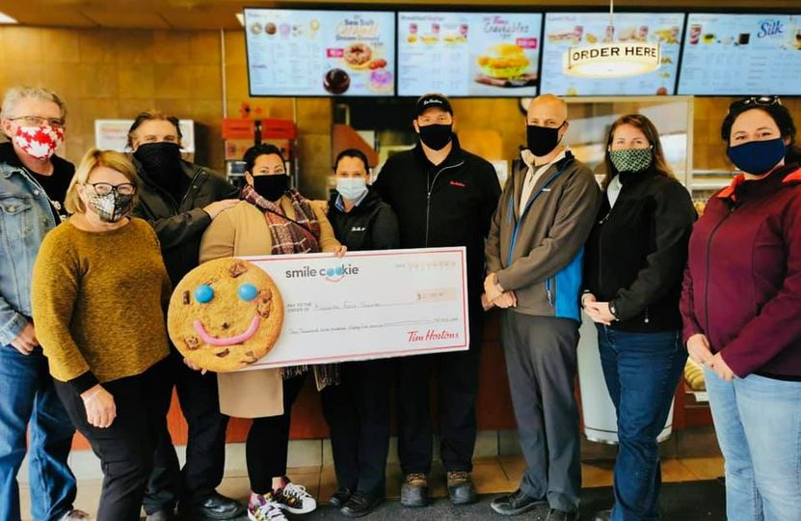
I GET IT

Slide 6
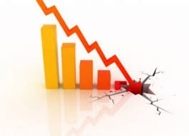
What comes to mind?

Slide 7
The stats are scary!

Slide 8
What’s the problem?
How are we doing?
Notes:
2 main issues – inward focussed
Revenue targets
Profits
Efficiencies
Stock Price
Etc.

Slide 9
What’s the solution?
Are We Adding Value?
Notes:
Customer Satisfaction
Customer Retention
Customer Engagement
Customer Loyalty
Etc.

Slide 10
What’s the problem?
Not Flexible

Slide 11
CCI and Non-Profits

Slide 12
CCI and Non-Profits

Slide 13
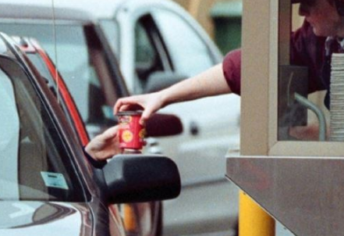
The Experience Economy
Commodities
Products
Services
Experiences
Transformational Experiences
Notes:
People find more value as you progress through the various stages of economies

Slide 14
They find more value in it
It resonates with them more
Excited to share with others
A great customer experience is intentionally designed to resonate with them and create loyalty to you and your brand.
Notes:
Studies show that 86% of buyers are willing to pay more for a great customer experience
Studies show that on average, customers are willing to pay a premium of 16% for the same product or service if it comes with an exceptional and compelling experience
Studies show that 72% of customers will share a positive experience with 6 or more people. This is great for customer loyalty, retention, marketing, and growth

Slide 15
SUPER CX
S - Surprising
U - Unique
P - Personalized
E - Engaging
R - Repeatable
Notes:
Surprise and Suspense – free dinner
Unique – Theme park vs Amusement park
Personalized – how can you make the experience feel like it was all about them?
Engaging – how can you include them in the experience (the design, the outcomes, the feedback)
Repeatable – make it as consistent as possible, no matter what day, or which person they interact with

Slide 16
Where Are Some Opportunities for You to Operate in The Experience Economy?
Donors?
Members?
Volunteers?
Your Community?
Your website…your building…your events…etc.
Notes:
Churches
KLSRC – Active Again program – Walking Rugby

Slide 17
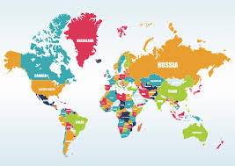
WHAT ABOUT INNOVATION?
McKinsey Study in 2016
Notes:
Recent study by McKinsey
Surveyed
10,000 CEO’s
From over 30 countries
AND 1 planet!

Slide 18
WHAT ABOUT INNOVATION?
84%
Notes:
Recent study by McKinsey
84% of executives considered their future
success to extremely dependent
on creating a culture of innovation within their organization.
Why? - Disruptors are everywhere (competitors, economic downturns, changes in consumer habits….pandemics!)

Slide 19
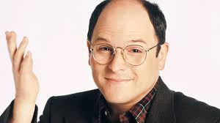
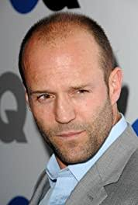
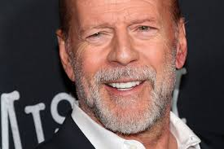
6 Tips to create a culture of innovation:
Be intentional about having innovation/brainstorming meetings
Diversity and inclusion
Question your assumptions and biases
Start from a position of empathy
Go small – pilot
Test…test…test – get feedback!

Slide 20
Notes:
Now she is getting the hang of it “PAFN, WTF?” – Wow That’s Fun!
Change is not easy! But if my mom can try, so can you!

Slide 21
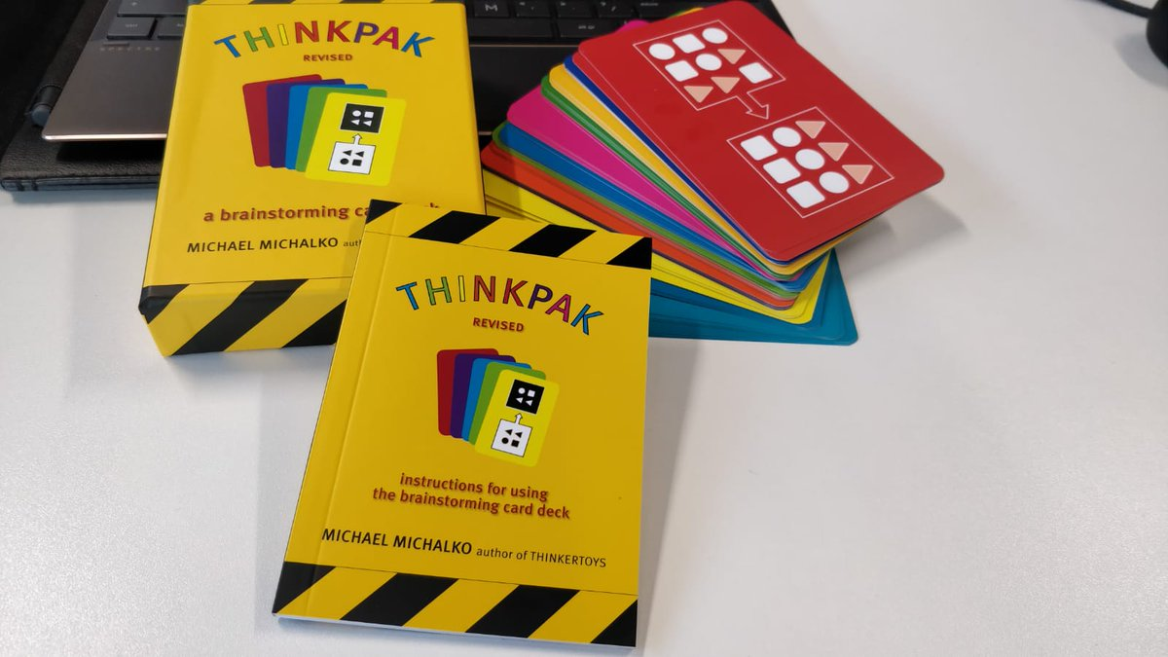
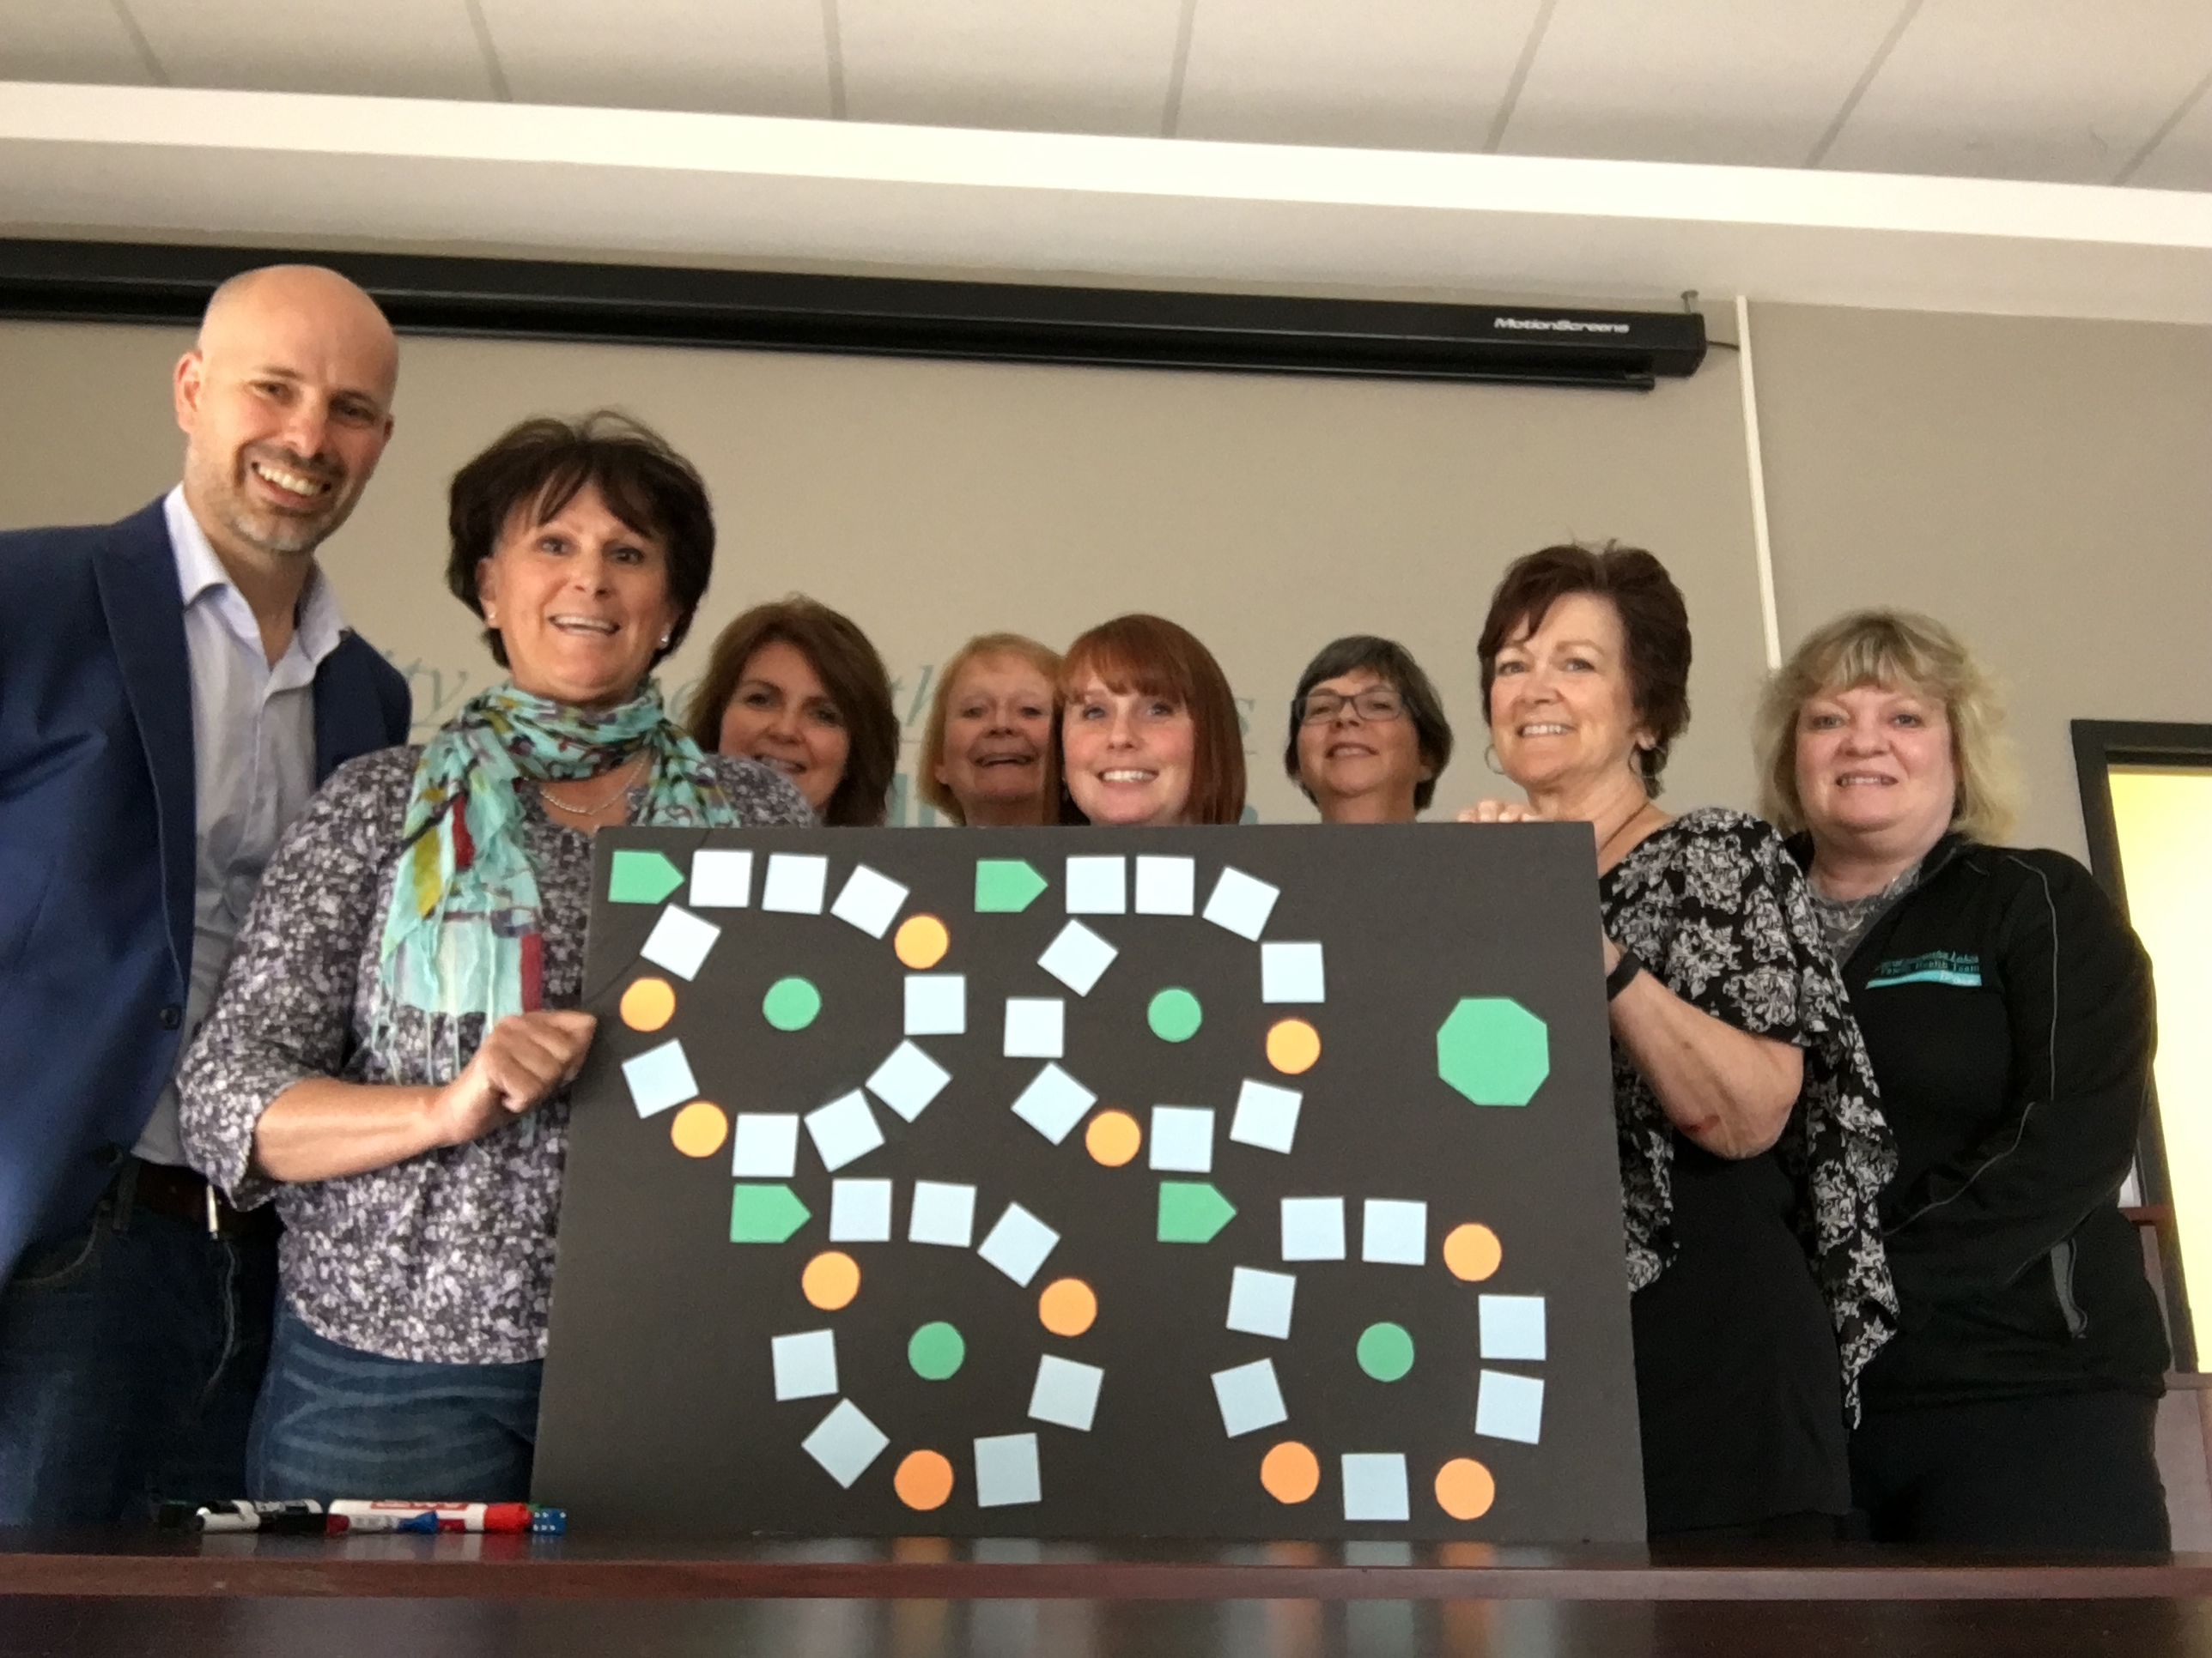
WHAT TOOLS CAN YOU USE TO SPARK IDEAS?
Notes:
Card Decks
Innovation Game

Slide 22
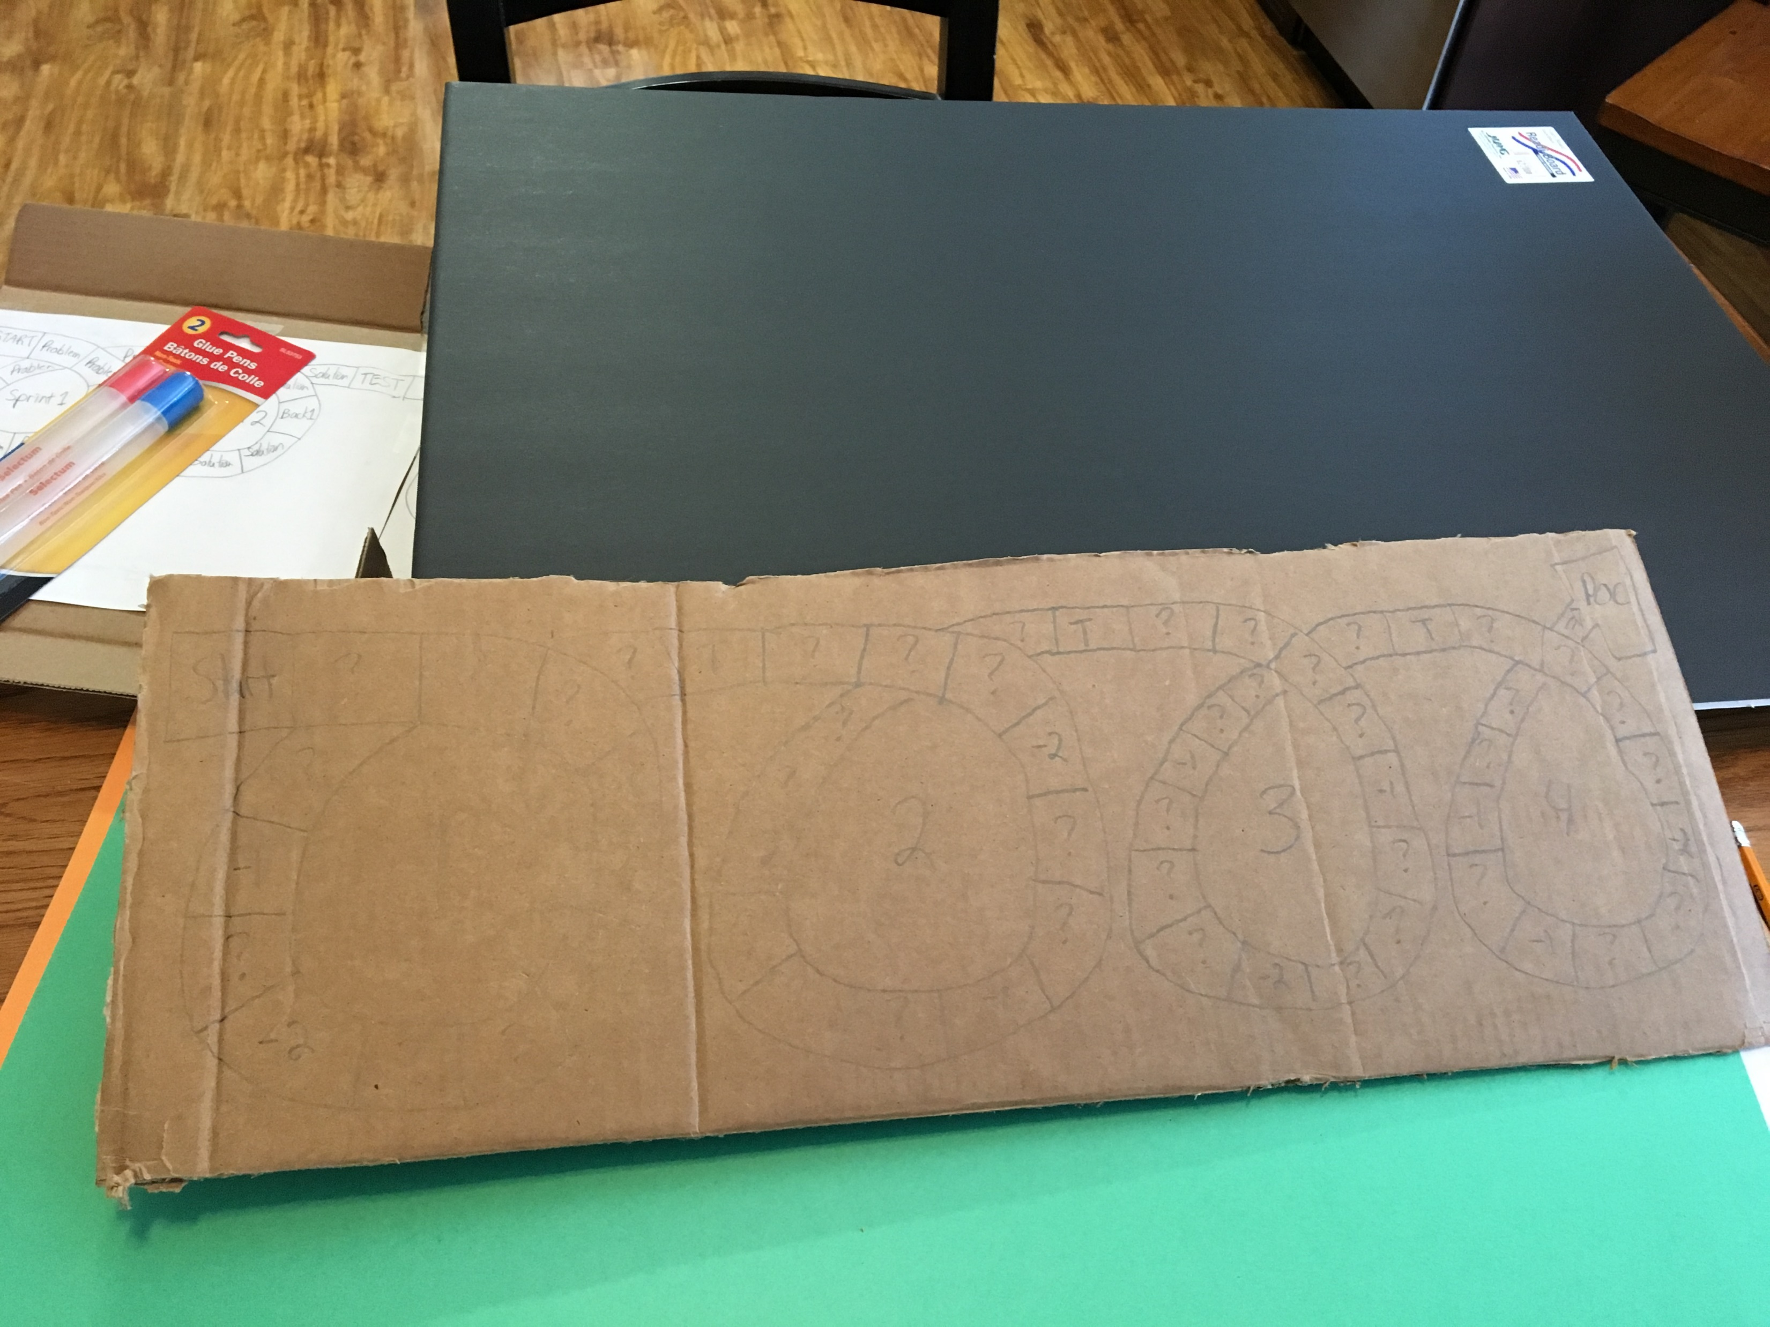
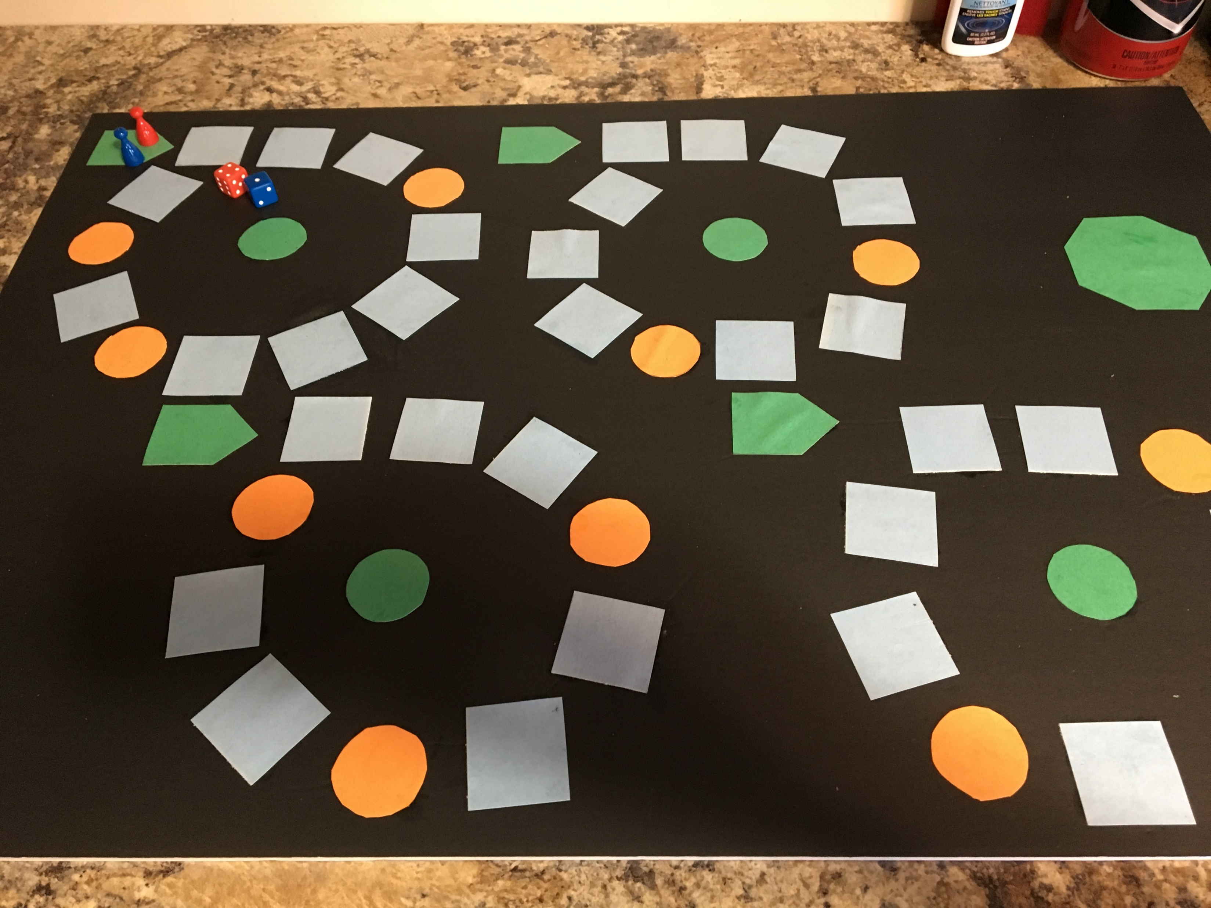
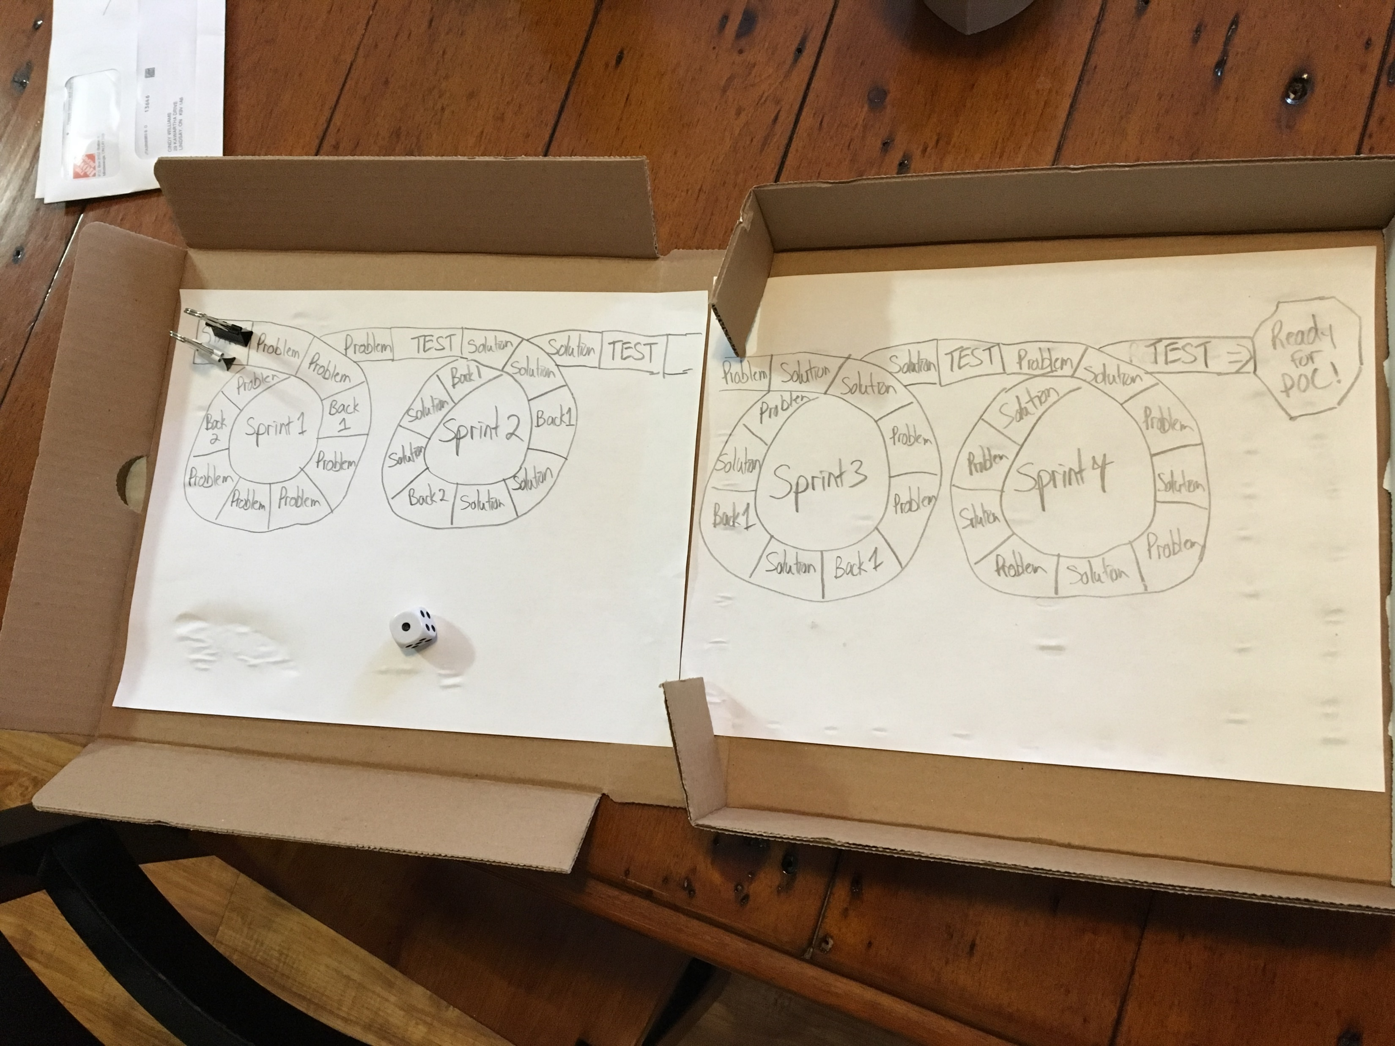
Innovation game - prototypes
Notes:
The Innovation Game is a product of the Innovation Practices that I teach:
Pizza Box
Hand Drawn - $0
$10 a Staples
Played it with businesses to pilot the idea
Now being turned into an online game – businesses can pay for a monthly subscription, log in and play

Slide 23
WHAT ABOUT INNOVATION?
Be intentional about finding new and better ways to do things!
Where can you be innovative?:
Fundraising
Events
Operations
Website
Physical location
And more!

Slide 24
WHAT’S NEXT?
Get to know who you serve
Create the ultimate CX for them
Dare to be different!

Slide 25
THANK-YOU!
WEB
www.zero-in.ca
Amazon
The Kent Bookstore in Lindsay
EMAIL - dennisgeelen@live.com
Cell – 705-821-1201

