Slide 1
Stop Wasting Time Networking
PAFN February 25th, 2016
Notes:
Too busy to waste time – everything should lead to results
Why networking is important for fundraisers
Today, learn some great networking tips:
How to introduce yourself (elevator speech)
How to enjoy networking by being good at it

Slide 2
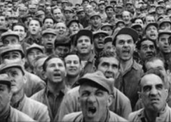
What IS networking?

Slide 3
What IS networking?
A supportive system of sharing information and service among individuals and groups having a common interest. Dictionary.com
Creating a group of acquaintances and associates and keeping it active through regular communication for mutual benefit. Networking is based on the question "How can I help?" and not with "What can I get?“ Business Dictionary.com

Slide 4
Why is important for
networking
fundraisers

Slide 5
Fundraisers use networking for ...
Developing case for support
Prospective donor research
Finding volunteers
Increasing sphere of influence – corporate, gov., social, civic, professional
PR/Communications – mission & vision
Notes:
HAVE A PLAN –
important part of your PR/Communications plan for your organization – talk about mission, share vision
Sphere of influence – corporate, government, social, civic, professional, religious
Prospective donor research
Secure the gift – case for support
Find volunteers
As the fundraiser you are often the face – like it or not
Official and unofficial networking events

Slide 6
How to stop networking
wasting time

Slide 7
“How can I help?”
Adopt a new attitude. Surround yourself with people that you think you can learn from, rather than people who you think can help you.
Be generous with your knowledge and connections.

Slide 8
Ask questions
Write down some great questions as conversation starters, then practice. Then practice them again. You might need a trusted friend to help you.
You only get one chance to make a first impression so be prepared.

Slide 9
Have a reason
Attend new places and events with a purpose in mind. Know why you’re there - $1m, a planned gift, a board member or gift in kind?
Make it a goal to connect with at least two new people, and to follow up with them the next day to make the relationship ‘stick’.

Slide 10
Your reputation precedes you
Look at the way you present yourself, and the way that you interact with others, on your online platforms.
Make sure that your picture of yourself, your posts and the opinions that you express online are SFW – Suitable for Work - and that they align with the image that you want people to notice when they meet you in person.
Try Googling yourself to make sure that you are presenting a positive impression to the world.

Slide 11
Be the connector
Make yourself the centre of your own network by introducing people who don’t know one another. Become a linchpin.

Slide 12
Speak silently
Learn the art of body language and how to make people come to you in the room.
Study effective techniques to start (and end!) a conversation.
How and when to do the business card thing

Slide 13
A riddle

Slide 14
A great elevator speech
Concise – 3 sentences max
Clear – would granny understand?
Tell a story – use case for support
Create a picture – how you help
More than one – be ready for all occasions
Write it down
Practice, practice, practice

Slide 15
Be Michelangelo
Develop a powerful elevator speech and use it. Chisel away at a long winded response until it is clean and crisp. Remember, when Michelangelo was asked how he created his sculpture of David he supposedly said, “It was easy. All I did was chip away everything that didn’t look like David.”

Slide 16
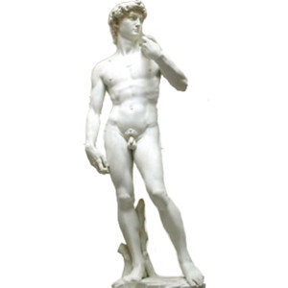
Be David
A good elevator speech ISN’T easy, but the effort is well worth the reward.

Slide 17
Follow up

Slide 18
Prepare, prepare, prepare
Networking can be a huge waste of time – but it doesn’t have to be.
Approach a networking event like a donor request. NOW you know what to do!

Slide 19
And of course
For heaven’s sake – don’t arrive at an event hungry! Nobody ever made a good impression with asparagus in their teeth.

Slide 20
How not to network
https://www.youtube.com/watch?v=pwGqPHAj6Kw

Slide 21
Remember
“First you have to be visible in the community. You have to get out there and connect with people. It’s not called net-sitting or net-eating. It’s called networking. You have to work at it.”
Dr. Ivan Misner
Notes:
founder and Chairman of business networking organization BNI, called the “Father of Modern Networking” by CNN and the “Networking Guru” by Entrepreneur magazine.

Slide 22
Congratulations
Why networking is important for fundraisers
How to stop wasting time networking

