Slide 1
PR and FR – a happy marriage to more $$$$

Slide 2
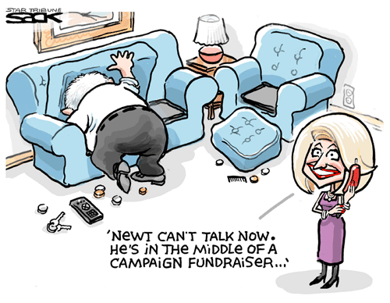
How can good PR help?

Slide 3
Key assumptions for today:
PR function often attached to other important work for fundraisers.
Smaller orgs have even less time and resources for it.
PR supports fundraising but doesn’t always generate income.
Local community media supportive, love to take pictures of volunteers on walks.
This can be both a strength and a weakness.
Notes:
PR is often an add-on for smaller agencies, or something that’s considered after all the vent planning, donor phoning and volunteer organizing are finished. Is overall mission, key messages and case studies being lost in the great photos of people walking, paddling and biking – volunteers having fun. Does this increase donations? Is there a spike in giving immediately after an event?

Slide 4
FR and PR – smart PR can help with new prospects
Good coverage helps prospects find you and brings in volunteers.
A few good media stories help raise your profile in the community. So does planned social media.
Media stories then become part of your prospecting kit.
Coverage leads to credibility – what you do matters.
It takes planning and some elbow grease.
The media want to cover you, but you have to give them some real news.
Notes:
Planned means thinking things out – it means keeping a constant presence even when nothing “big” is happening. It means attracting followers who then come to your website to check you out.

Slide 5
How to begin?
If you’re a big organization, you can afford either a designated PR person or an outside firm.
If not, you can do the work in your own office.

Slide 6
Quick to-do
Prepare a kit for your media volunteers.
Have an up-to-date media list and keep refreshing it. Include bloggers on MS (for example)
Include recent media releases, any clippings or paper copies of on-line coverage. Also links to videos.
Includes key messages, mission/vision statement, recent case studies, and photos showing the need.
Notes:
Compile a list of

Slide 7
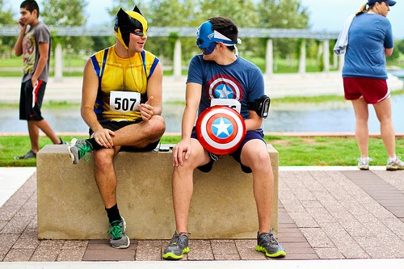
Notes:
IF you can designate a volunteer photographer, you can get some great shots to attach to your press release or event notice.

Slide 8
Include who gets helped – not always happy photos
Notes:
My research showed me that donors are more likely to respond to sad photos than happy ones, because they touch the heart. 80 per cent emotion, 20 percent hard data.

Slide 9
Are you newsworthy?
Do your research – know which reporter or editor covers your area. They change.
Read a lot – bloggers in your discipline, and just outside it.
Start to identify trends and passions in your bloggers
Put yourself in reporter’s shoes. Help with video assets and photos if working with television.
Notes:
Do some homework – it takes a little time and effort but it will pay off in the long run. Find your bloggers – with fragmented media, if you can get a guest blog in, or start commenting on their blogs in the comments section, you give your non profit more exposure and help to position yourself as an expert in the field.

Slide 10
What IS a story anyway?
Timely – about to happen, or happened within last 12 hours
For news and features: Unique, compelling
Relevant and innovative
Can easily find an audience
Types of stories: events, profound cures (children especially) announcements, feature story (case study), trend/survey story – stunning data on MS.
Notes:
For fundraisers, it’s complicated. You want to keep your profile up, so don’t restrict yourselves to special events, Have a target of how often you want to appear in the news, and then find ways to reach it. Build confidence in your donors – there they are again, or there is someone who was helped by my donation,

Slide 11
Helping the reporter
Have a website link and post all your releases and new initiatives on your site. Quickly. Like, right now.
When you send out a release, tweet the daylights out of it.
Provide background info – separate it out from the body of your release.
Watch how reporters put their stories together.
Become a resource – if you are an expert in your field, let them know. Become a Go To person.
Get media training.
Notes:
If you are an expert call the media who follow your area and introduce yourself. If you have published academic papers, written a book, write a blog, tell them and give them the link. Indicate that you would be happy to comment when they are writing about something in your area of expertise. Ask for a short meeting. Tell them what it’s like in a daily newsroom.
I looked at your sites, and the ones I liked the best were Alzeimers and YES. As a potential donor they met my needs – YES put great stats right in my face, Alzeimers had tons of useful and helpful information.
Admittedly flagrant pitch at the end

Slide 12
What is not a story
Greyer area than it used to be with the advent of blogging.
Free donor pitch. A story: New canoe comes complete with a life story, or compelling anecdotes.
Poor timing – you simply aren’t ready to take it out there yet.
Notes:
Use your blog as an example…picking on Dick. Discuss timing issue with Lindsay story – had to be recast because it was already covered in August and most editors don’t redo an issue inside of six months. Bloggers might be even longer between times….

Slide 13
What is a press release?
A press release is a brief document written out in a specific format that is used to pitch a story to a reporter or editor, or to make a newsworthy announcement.
It is only one tool in your public relations toolbox.
Notes:
Remember this is only one tool. Be prepared to work a release, and if it falls flat call the reporter and ask why. Don’t call at deadline time. Ask if they can spend a few minutes telling you what they would have found compelling instead. The tips they give you will be invaluable in the future. I got a wakeup call from Lois Tuffin on this recently. x

Slide 14
What isn’t a press release?
An ad, or a promotion.
A media advisory or a photo op announcement. Those are good, but different.
A backgrounder, standby statement, talking points sheet or a Q and A document.
A speech.
Notes:
Media advisories get the media to come out and cover the event. I have a template that I use and can share if you get in touch with me.

Slide 15
Common press release bloopers
All upper case characters – compose normally.
Grammatical errors
Spelling mistakes – quick trip to the round file for your release
Lack of content
Press releases that scream DONATE! Or, AREN’T WE GREAT!
Hype Flags - these will trip spam filters. An abundance of exclamation points. Red letters.

Slide 16
Plan your objectives. Know WHY you are putting out a release. Exactly what do you want? A story? A mention? An interview?
Momentum? Donor reassurance? New prospects?
A spot on your website? (should be there anyway) A mention in a blog?
Make sure it’s got potential. Legs. Energy. Interest. Timeliness. ( Last week’s news is fish wrap.)
Check your budget. If you are planning on putting your release out on a newswire such as CNW http://www.newswire.ca, realize that it costs money.
Notes:
Also note that it does cost money to raise money. In my research I read somebody important in the field who said that to say otherwise is ridiculous. Donors want to know you run a good shop, not necessarily a cheap shop.

Slide 17
Press release “musts”
Are prominent people involved? Does your story have a human side to it? Local angle?
Can it be tied to a larger issue? (CNW release example - anorexia)
Target your releases.
Media lists
Bloggers
Websites
Newsletters
FB pages

Slide 18
More press release “musts”
Use the proper press release format.
Inverted pyramid ---------- boilerplate.
Read it out loud.
Have someone else check it for grammar and spelling.
Keep the press release concise and clear. Get to the point in the first paragraph. If you have two key points, the second point goes in the second paragraph.
Always cover Who, When, Where, What and Why and Why should anyone care, right up front.

Slide 19
Press release “musts, must nots”
Avoid buzzwords, hyperbole, adjectives, and exaggeration.
DON’T USE BOLDFACE AND DON’T USE CAPS.
Avoid boring useless quotes that don’t advance your story and won’t get used. A killer usually starts with “I am delighted...”
Don’t fill the release with trendy words and phrases like “holistic.”
Local media are more forgiving than others.

Slide 20
Press release “musts”
Write an excellent headline. The headline is 90 per cent of the release.
If the headline can’t stand on its own, go back to the beginning and ask yourself if you really have something newsworthy to say.
SEO keywords – use them (usually, a string of words).
Always have a boilerplate paragraph.
Make sure it’s “tweetable.” (if possible)
Notes:
Boilerplate – who you are, what your mission is, how many people you serve annually, geography, details like that. Keep it constant. Use GPIC example.

Slide 21
More “musts”
Paste the press release into the body of the email.
Have a good email subject line. Like a second headline.
Watch the “from” line. Use your organization’s name,
not yours, unless you are well-known and trusted.

Slide 22
Press release template
FOR IMMEDIATE RELEASE
Headline (use larger type and center it)
Dateline – PETERBOROUGH, ON – May 6, 2016 –Introductory paragraph or “lede.”
Second paragraph offering more information, or your second major point or message.
Third paragraph usually is a quote attributed to somebody important that advances your story or message and may offer more pertinent information.

Slide 23
Template cont’d
Fourth para gives more information and possibly another quote.
Fifth paragraph is usually your boilerplate information.
Contact information:
Always at the bottom left-hand side of the release.
Include phone numbers, email addresses, and best hours if applicable.

Slide 24
Big Rule
If humanly possible, always keep your release to one page in length.
Everything else can be on a separate sheet of talking points or contained in a Q and A document.

Slide 25
Thank You
Future Best Write communications workshops:
Media relations 101 – what’s in the toolkit?
How to take the terror out of a media interview.
In a crisis? No plan? How to turn things around fast.
How to organize a press conference
Contact me at bestwritecom@gmail.com.705- 772-7692

